Slide 1

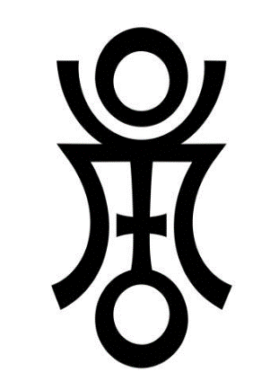
Frames
Phaethon & The Anunnaki Calculation
Paul McKay Easter
Fairbanks, AK
paul.m.easter@gmail.com
972-474-7501
Archaeological Renaissance: Part IV

Slide 2
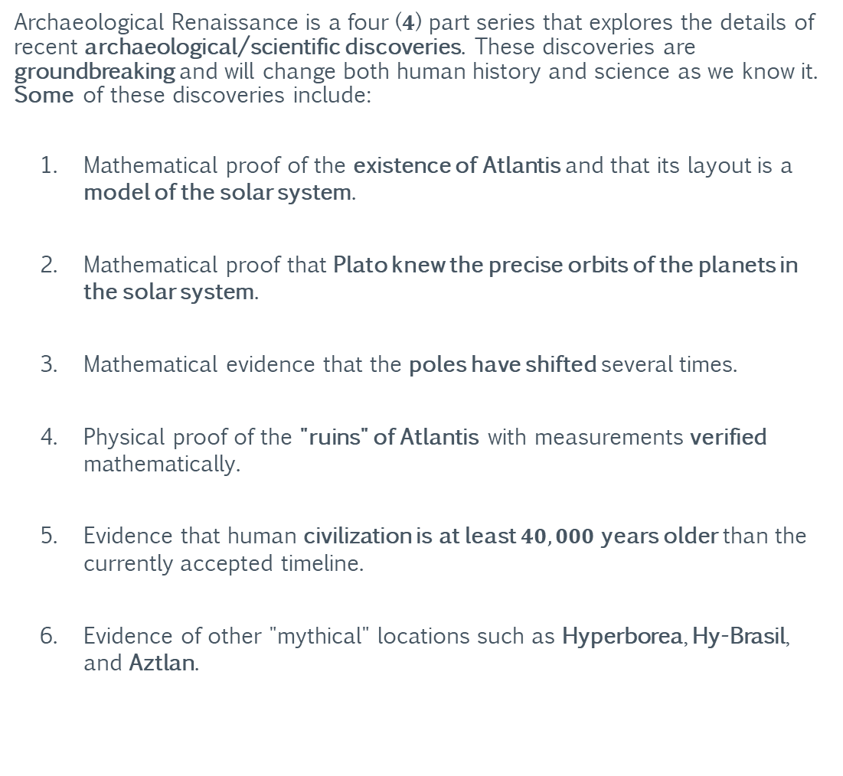
Archaeological Renaissance
Summary
Archaeological Renaissance is a four ($4$) part series that explores the details of recent archaeological/scientific discoveries. These discoveries are groundbreaking and will change both human history and science as we know it. Some of these discoveries include:
Mathematical proof of the existence of Atlantis and that its layout is a model of the solar system.
Mathematical proof that Plato knew the precise orbits of the planets in the solar system.
Mathematical evidence that the poles have shifted several times.
Physical proof of the "ruins" of Atlantis with measurements verified mathematically.
Evidence that human civilization is at least $40,000$years older than the currently accepted timeline.
Evidence of other "mythical" locations such as Hyperborea, Hy-Brasil, and Aztlan.
Part I: Ants
Part II: Pivots
Part III: Projections
Part IV: Frames

Slide 3
Archaeological Renaissance
This Information Shall Remain Free
Grant of Public License
This document is part of a software program. The software program, which includes its documentation, is free: you can redistribute it and/or modify it under the terms of the GNU General Public License as published by the Free Software Foundation, either version 3 of the License, or (at your option) any later version.
This program is distributed in the hope that it will be useful, but without any warranty; without even the implied warranty of merchantability or fitness for a particular purpose. See the GNU General Public License for more details.
You should have received a copy of the GNU General Public License along with this program. If not, see https://www.gnu.org/licenses/.
Part I: Ants
Part II: Pivots
Part III: Projections
Part IV: Frames

Slide 4
Archaeological Renaissance
This Information Shall Remain Free
Grant of Current and Future Patents
All rights to any current and future patents, having derived from any quantity of unique and/or proprietary information contained within the software program, generated by the software program, or derived from the use and/or reverse engineering of the software program are reserved.
All reserved rights of said patents are hereby granted to the public.
Image Copyrights
Some images used in this document were acquired through a public image search engine and their use is covered under United States “fair use” laws for academic/non-commercial distribution. However, some images may be subject to additional copyright(s) and/or commercial redistribution restrictions.
Part I: Ants
Part II: Pivots
Part III: Projections
Part IV: Frames
https://www.dmlp.org/legal-guide/fair-use

Slide 5
For Elaina, Collin, and Arianna: This lost world I’ve found; I rebuild for you.
-Dad

Slide 6
Section I: The Descent of Phaethon
The following section examines the myth of Phaethon and how its details relate to possible cataclysms on Earth and throughout the solar system. The section also examines the science of calculating the age of (dating) organic material, known as radiocarbon dating.

Slide 7
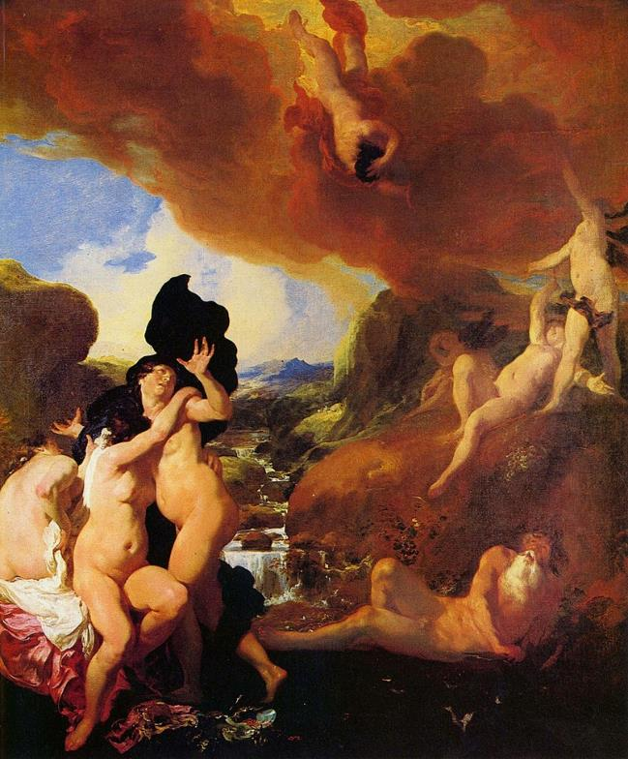
The Descent of Phaethon
The Mythology of Phaethon
Phaethon was the son of the Oceanid Clymene and the sun god Helios in Greek mythology. His name was also used by the Ancient Greeks as an alternative name for the planet Jupiter, the motions and cycles of which were personified in poetry and myth.
Phaethon, out of desire to have his parentage confirmed, travels to the sun-god's palace in the east. There he is recognized by his father and asks him for the privilege to drive his chariot for a single day.
Despite Helios' fervent warnings and attempts to talk him out of it, counting the numerous dangers he would face in his celestial journey and reminding Phaethon that only he can control the horses, the boy is not dissuaded and does not change his mind.
https://en.wikipedia.org/wiki/Phaethon

Slide 8
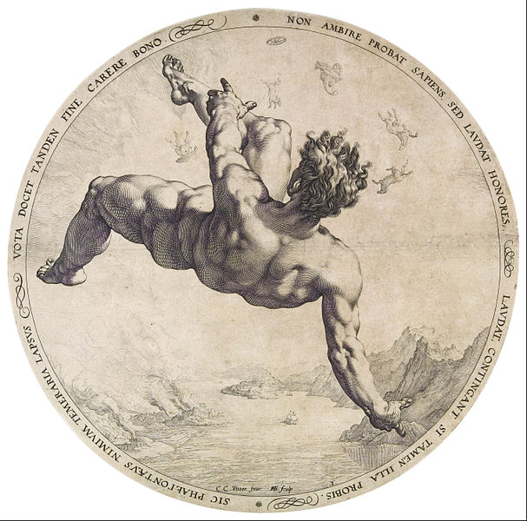
The Descent of Phaethon
The Mythology of Phaethon
He is then allowed to take the chariot's reins; his ride is disastrous, as he cannot keep a firm grip on the horses. As a result, he drives the chariot too close to the earth, burning it, and too far from it, freezing it.
In the end, after many complaints, from the stars in the sky to the Earth itself, Zeus strikes Phaethon with one of his lightning bolts, killing him instantly. His dead body falls into the river Eridanus, and his sisters the Heliades are turned to black poplar trees as they mourn him.
https://en.wikipedia.org/wiki/Phaethon

Slide 9
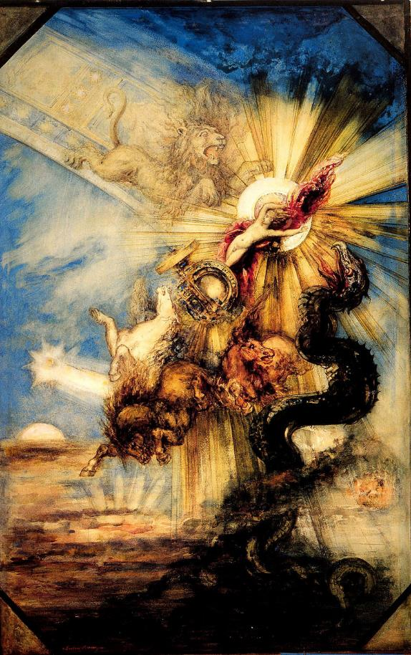
The Descent of Phaethon
Plato’s Story of Phaethon
In Plato's Timaeus, Critias tells the story of Atlantis as recounted to Solon by an Egyptian priest, who prefaced the story by saying:
“There have been, and will be again, many destructions of mankind arising out of many causes; the greatest have been brought about by the agencies of fire and water, and other lesser ones by innumerable other causes. There is a story that even you [Greeks] have preserved, that once upon a time, Phaethon, the son of Helios, having yoked the steeds in his father's chariot, because he was not able to drive them in the path of his father, burnt up all that was upon the earth, and was himself destroyed by a thunderbolt.
Now, this has the form of a myth, but really signifies a declination of the bodies moving in the heavens around the earth, and a great conflagration of things upon the earth, which recurs after long intervals”
https://en.wikipedia.org/wiki/Phaethon

Slide 10
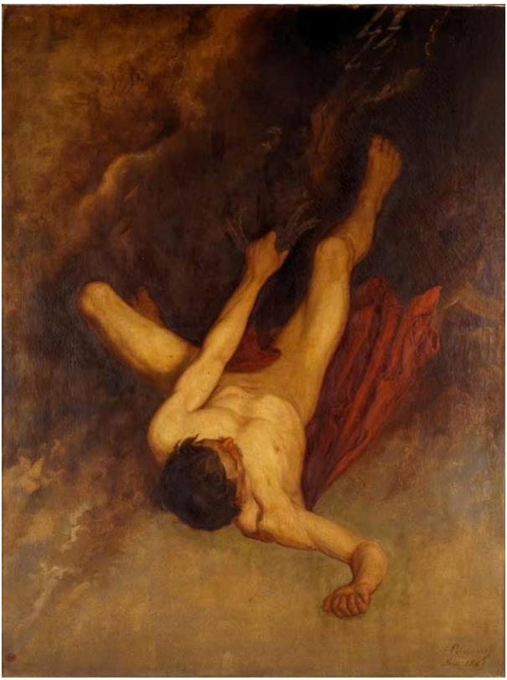
The Descent of Phaethon
Plato’s Story of Phaethon
Plato is explaining that the story of Phaethon, while obviously in the form of a myth, is based in truth.
And that an event occurred that was not only responsible for the “declination of the bodies moving in the heavens” (i.e., planets, moons, etc.) but also responsible for reoccurring cataclysms on the Earth.
https://en.wikipedia.org/wiki/Phaethon

Slide 11
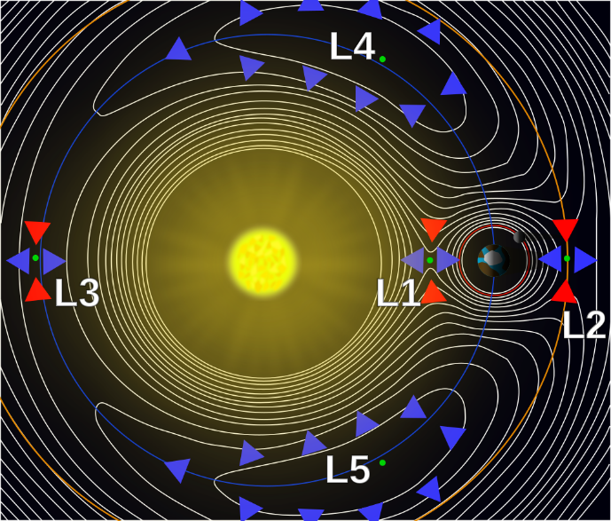
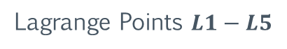
The Descent of Phaethon
Lagrange Points
In celestial mechanics, the Lagrange points are points of equilibrium for small-mass objects under the influence of two massive orbiting bodies. Mathematically, this involves the solution of the restricted three-body problem in which two bodies are very much more massive than the third.
Normally, the two massive bodies exert an unbalanced gravitational force at a point altering the orbit of whatever is at that point. At the Lagrange points, the gravitational forces of the two large bodies and the centrifugal force balance each other.
This can make Lagrange points an excellent location for satellites, as few orbit corrections are needed to maintain the desired orbit. Small objects placed in orbit at Lagrange points are in equilibrium in at least two directions relative to the center of mass of the large bodies.
Lagrange Points $L1−L5$
https://en.wikipedia.org/wiki/Lagrange_point

Slide 12
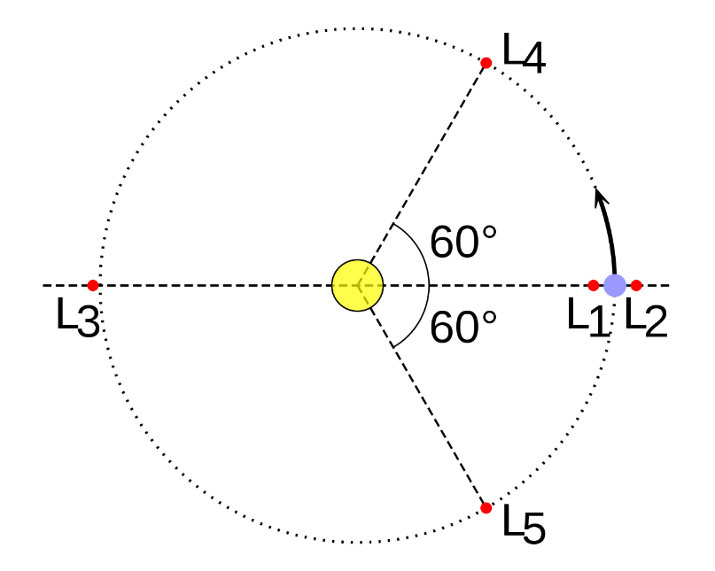
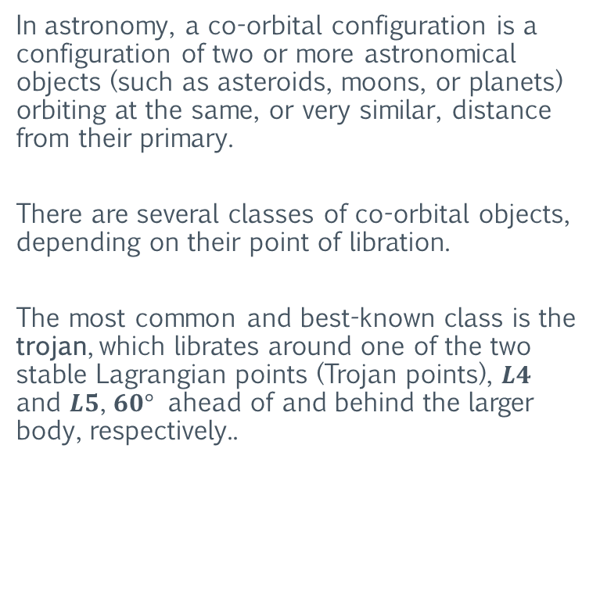

The Descent of Phaethon
Co-Orbital Configuration
In astronomy, a co-orbital configuration is a configuration of two or more astronomical objects (such as asteroids, moons, or planets) orbiting at the same, or very similar, distance from their primary.
There are several classes of co-orbital objects, depending on their point of libration.
The most common and best-known class is the trojan, which librates around one of the two stable Lagrangian points (Trojan points), $L4$ and $L5$, $60°$ ahead of and behind the larger body, respectively..
Trojans (Lagrange Points $L4 \& L5$)
https://en.wikipedia.org/wiki/Co-orbital_configuration

Slide 13
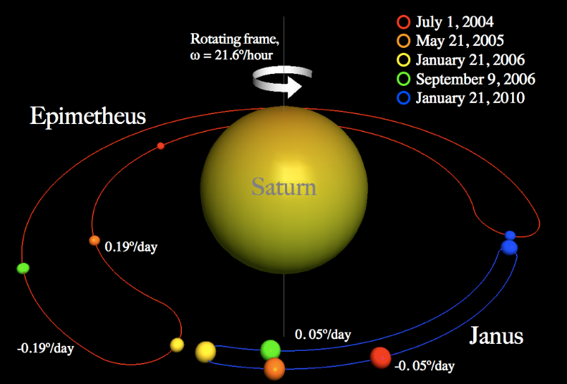
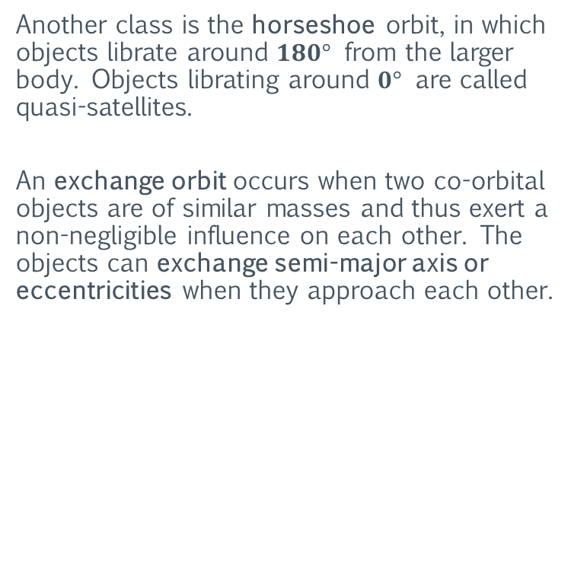
The Descent of Phaethon
Co-Orbital Configuration
Another class is the horseshoe orbit, in which objects librate around $180°$ from the larger body. Objects librating around $0°$ are called quasi-satellites.
An exchange orbit occurs when two co-orbital objects are of similar masses and thus exert a non-negligible influence on each other. The objects can exchange semi-major axis or eccentricities when they approach each other.
Co-orbital Moons
https://en.wikipedia.org/wiki/Co-orbital_configuration

Slide 14
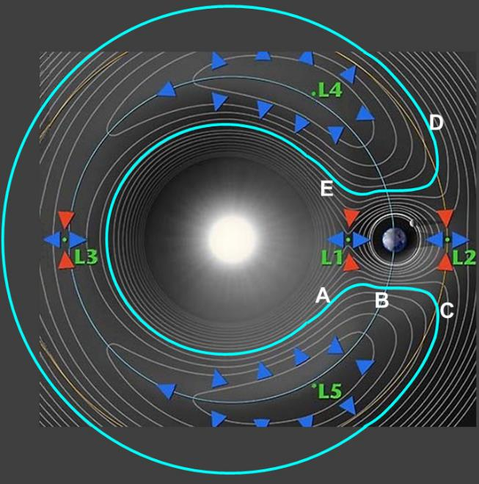
The Descent of Phaethon
The Horseshoe Orbit
In celestial mechanics, a horseshoe orbit is a type of co-orbital motion of a small orbiting body relative to a larger orbiting body. The osculating (instantaneous) orbital period of the smaller body remains very near that of the larger body, and if its orbit is a little more eccentric than that of the larger body, during every period it appears to trace an ellipse around a point on the larger object's orbit.
However, the loop is not closed but drifts forward or backward so that the point it circles will appear to move smoothly along the larger body's orbit over a long period of time. When the object approaches the larger body closely at either end of its trajectory, its apparent direction changes.
Over an entire cycle the center traces the outline of a horseshoe, with the larger body between the “horns”.
Horseshoe Orbit
https://en.wikipedia.org/wiki/Horseshoe_orbit

Slide 15
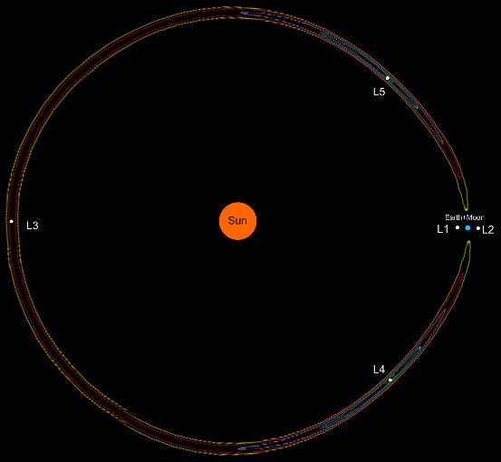
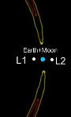
The Descent of Phaethon
The Horseshoe Orbit
The images to the right show the shape of a “thin” horseshoe orbit. Note the sharp turns (or “horns”) that denote a relative change in orbital direction.
https://en.wikipedia.org/wiki/Horseshoe_orbit

Slide 16
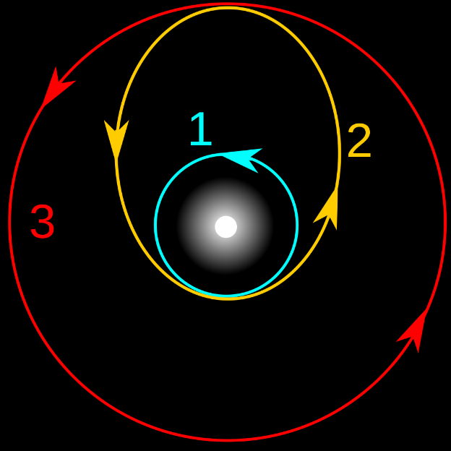
The Descent of Phaethon
Transfer Orbit
In orbital mechanics, a transfer orbit is an intermediate elliptical orbit that is used to move a spacecraft from one circular, or largely circular, orbit to another.
Two types of transfer orbits are the Hohmann and the bi-elliptic.
Hohmann Transfer Orbit
https://en.wikipedia.org/wiki/Transfer_orbit

Slide 17
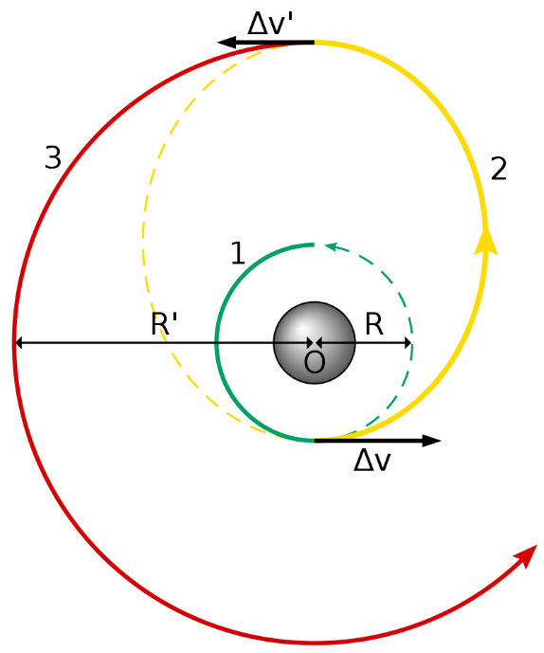
The Descent of Phaethon
Hohmann Transfer Orbit
The Hohmann transfer orbit is an elliptical orbit used to transfer between two circular orbits of different radii around a central body in the same plane.
The Hohmann transfer often uses the lowest possible amount of energy in traveling between these orbits, but bi-elliptic transfers can use less in some cases.
https://en.wikipedia.org/wiki/Hohmann_transfer_orbit

Slide 18
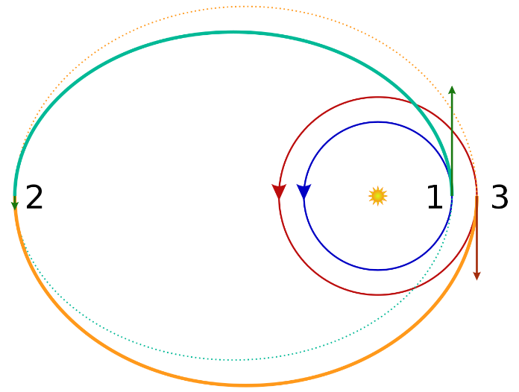
The Descent of Phaethon
Bi-Elliptic Transfer Orbit
The bi-elliptic transfer is an orbital maneuver that moves an object from one orbit to another and may, in certain situations, require less delta-v than a Hohmann transfer maneuver.
The bi-elliptic transfer consists of two half-elliptic orbits. From the initial orbit, a first burn expends delta-v to boost the object into the first transfer orbit with an apoapsis at some point away from the central body.
At this point a second burn sends the object into the second elliptical orbit with periapsis at the radius of the final desired orbit, where a third burn is performed, injecting the object into the desired orbit.
https://en.wikipedia.org/wiki/Bi-elliptic_transfer

Slide 19
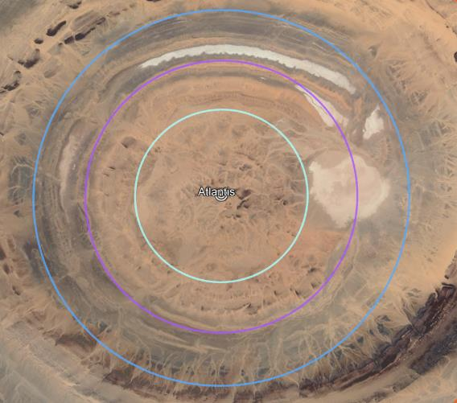
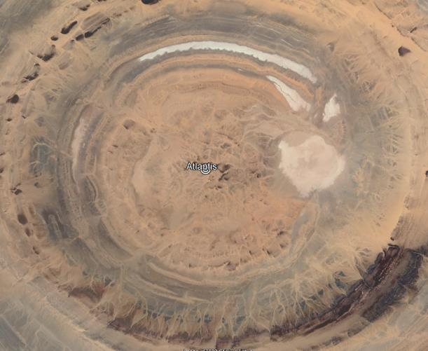
The Descent of Phaethon
The Horseshoe Orbit: Venus
The images below show orbital projection of Venus (purple). Note the virtual “model” of the horseshoe orbit created by the orbital path of Venus and the layout of the underlying structure.
Venus
Venus
https://en.wikipedia.org/wiki/Horseshoe_orbit

Slide 20
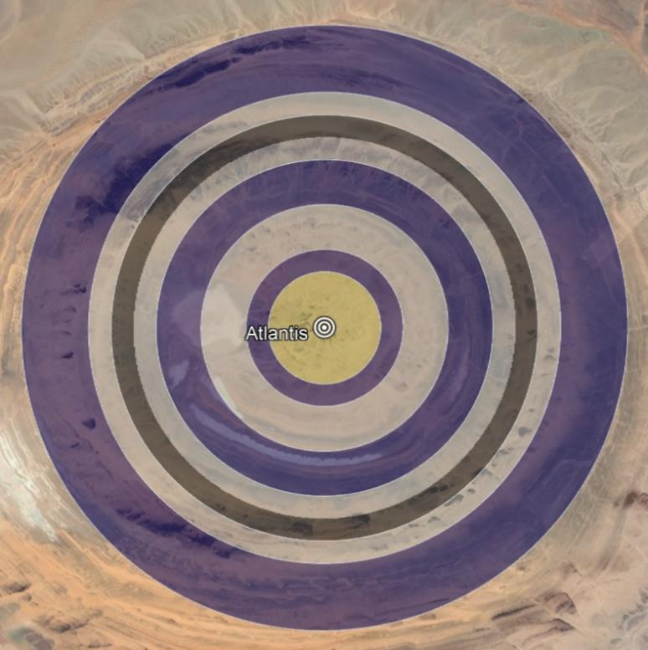
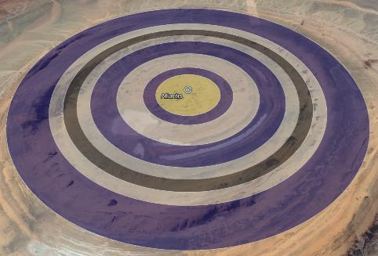
The Descent of Phaethon
The Race-Course of Atlantis
Race-Course
Plato states that a “race-course” (used for racing horses) was constructed in the center of the largest land zone. The track was one stadion (ka) in width and spanned the entire circumference of the zone.
In other words, an additional zone, one stadion (ka) in breadth, was placed “on top” of the last zone of land.
The images to the right show the location of the race-course.

Slide 21
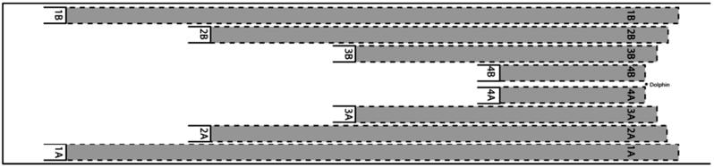
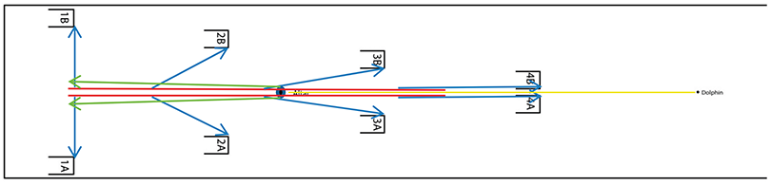
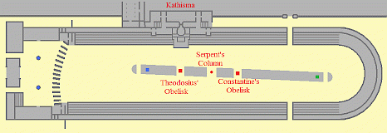
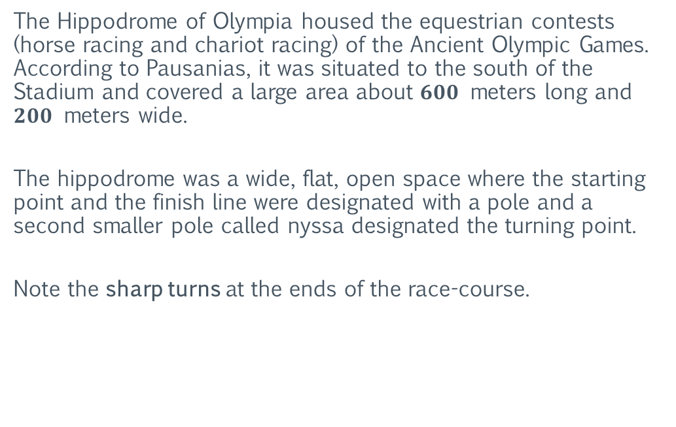
The Descent of Phaethon
Hippodrome of Olympia
The Hippodrome of Olympia housed the equestrian contests (horse racing and chariot racing) of the Ancient Olympic Games. According to Pausanias, it was situated to the south of the Stadium and covered a large area about $600$ meters long and $200$ meters wide.
The hippodrome was a wide, flat, open space where the starting point and the finish line were designated with a pole and a second smaller pole called nyssa designated the turning point.
Note the sharp turns at the ends of the race-course.
Hippodrome Starting Gate Positions
https://en.wikipedia.org/wiki/Hippodrome_of_Olympia

Slide 22
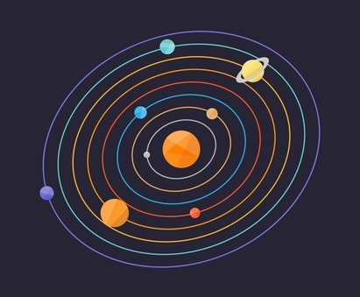
The Descent of Phaethon
The Disconnected Mass
Extremely complex orbital systems can be designed using varying combinations of these “exotic” orbit configurations and transfers.
However, implementation of an orbital system of this complexity (or even the modification of an existing orbit) would require technology far more advanced than what is available today.
One possibility is that an advanced civilization had the technology to “disconnect” objects from their mass. Perhaps this could be accomplished through mirroring of the object’s interaction with gravity, or “shielding” the object from the Higgs field.

Slide 23
The Descent of Phaethon
The Disconnected Mass
However, if a large object in the solar system (such as a planet) was disconnected from its mass, that mass would still need to “exist” in some form, even if its (the mass’s) physical location is greatly offset from the object .
This “invisible” mass would need to continue to interact with the mass of the other objects (in the object’s original orbital location) as well as maintain its contribution of mass to the center mass of the solar system.
Otherwise, the effectively complete removal of a large mass from the solar system would perturb the orbits of the other objects in the system.

Slide 24
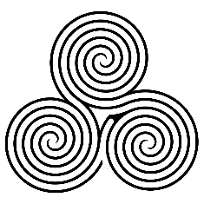
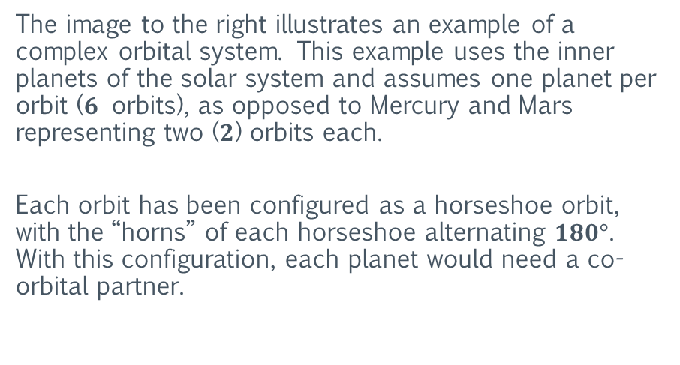
The Descent of Phaethon
The Labyrinth
The image to the right illustrates an example of a complex orbital system. This example uses the inner planets of the solar system and assumes one planet per orbit ($6$ orbits), as opposed to Mercury and Mars representing two ($2$) orbits each.
Each orbit has been configured as a horseshoe orbit, with the “horns” of each horseshoe alternating $180°$. With this configuration, each planet would need a co-orbital partner.

Slide 25
The Descent of Phaethon
The Labyrinth
One option would be to convert each planet’s moon to a co-orbiting partner. Planets without a moon would either need one “assigned” to it, or a mechanism to create a virtual co-orbiting partner using another form of “invisible” mass.

Slide 26
The Descent of Phaethon
The Labyrinth
One purpose of this type of orbital configuration would be to create a virtual “race-course” for an independent celestial object (such as a small moon or spherical body). This could be the race-course described by Plato.
This complex race-course would also resemble a labyrinth (or a maze with one path).
The image to the right illustrates how a celestial object, labeled “Phaethon”, would begin its journey through this labyrinth.
Phaethon
Start

Slide 27
The Descent of Phaethon
The Labyrinth
The image to the right illustrates the path of the Labyrinth.
Its possible for multiple objects (chariots) to navigate the Labyrinth at once.
Note that this path is relative to the primary co-orbiting partner (the planet inside the “horns”). The true path (absolute path) would look much different.

Slide 28
The Descent of Phaethon
The Labyrinth
Note that the inner boundary of what is now the asteroid belt begins just outside of the Labyrinth.
Asteroid Belt Inner Boundary

Slide 29
The Descent of Phaethon
The Labyrinth
One possibility is that the planetary disc (the plane of the orbits) of the inner planets was “expanded”.
The planets outside the orbit of Earth would be offset to the “south”, while the planets inside the orbit of Venus would be offset to the “north”.
The offset planets would continue their orbits as if there was a “copy” (mirror) of the Sun in the center of their orbital plane.
Labyrinth Side View

Slide 30
The Descent of Phaethon
The Labyrinth
Earth and Venus would remain on the original planetary disc plane.
The image on the right shows the side view of the Labyrinth with the planetary disc expanded.
The image shows Venus expanded to the “north”. However, this is only to illustrate the path of the Labyrinth.
Venus
Labyrinth Side View

Slide 31
The Descent of Phaethon
The Labyrinth
The images below show the top and side views of the Labyrinth.
Top View
Side View

Slide 32
The Descent of Phaethon
The “Thrown”
The Labyrinth
From a specific point of view to the “north”, the expanded orbits would “eclipse” each other. Meaning they would all appear to be the same size.
Eclipsed Top View
Side View

Slide 33
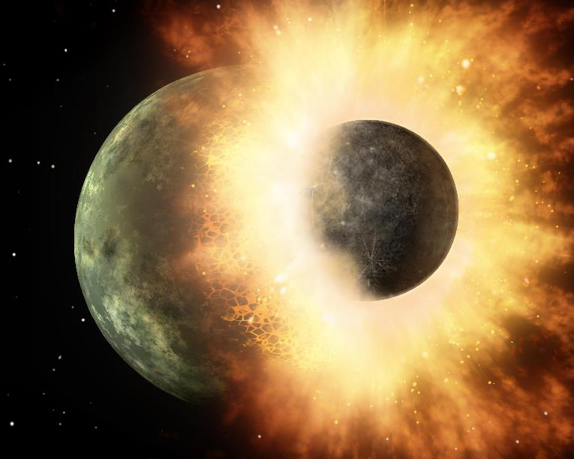
The Descent of Phaethon
The Labyrinth
The complex orbital configuration of this labyrinth could have set the stage for a massive cataclysm affecting most (if not all) of the solar system.
Evidence of such a cataclysm can be found throughout the solar system.
The remainder of this section will examine some of this evidence.

Slide 34
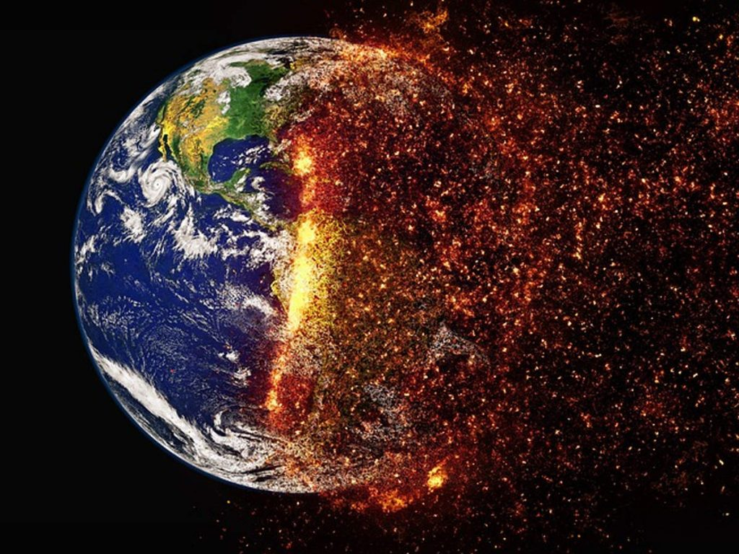
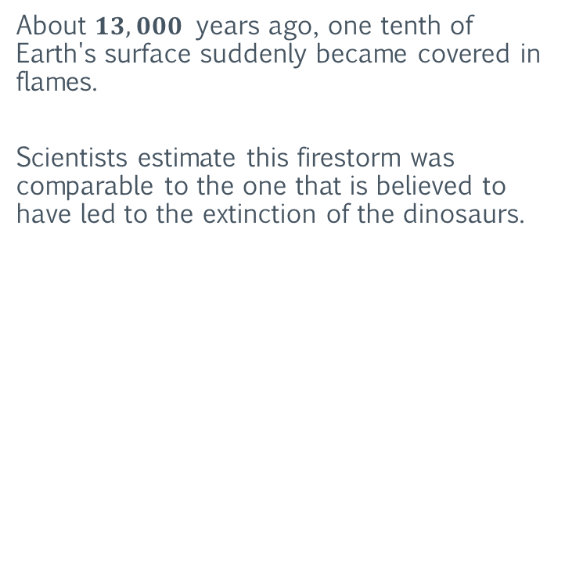
The Descent of Phaethon
The Poplars of Phaethon
About $13,000$ years ago, one tenth of Earth's surface suddenly became covered in flames.
Scientists estimate this firestorm was comparable to the one that is believed to have led to the extinction of the dinosaurs.
https://www.sciencealert.com/a-firestorm-bigger-than-the-one-that-killed-the-dinosaurs-triggered-an-ice-age-13-000-years-ago

Slide 35
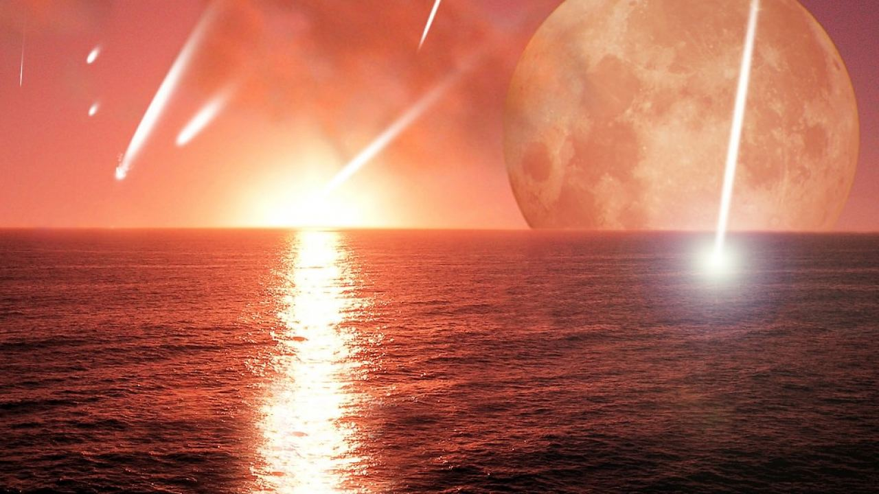
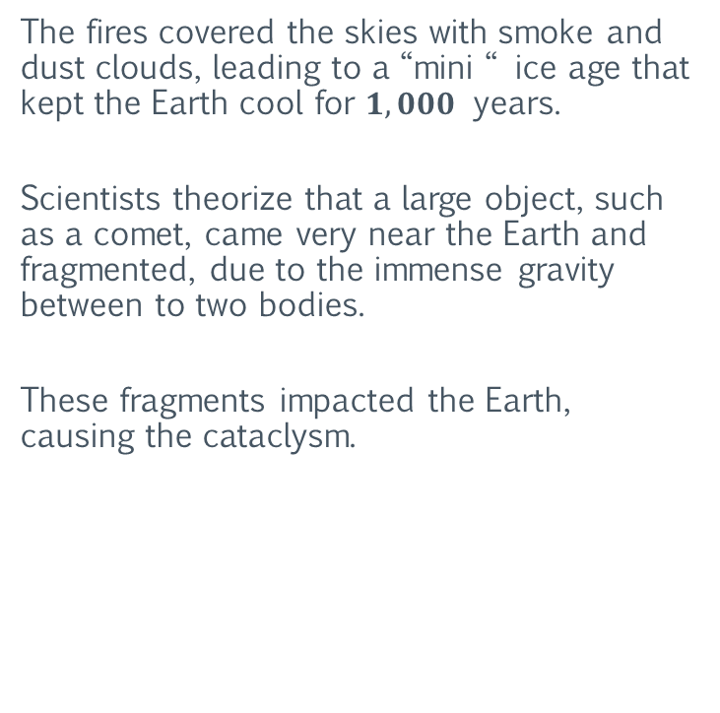
The Descent of Phaethon
The Poplars of Phaethon
The fires covered the skies with smoke and dust clouds, leading to a “mini “ ice age that kept the Earth cool for $1,000$ years.
Scientists theorize that a large object, such as a comet, came very near the Earth and fragmented, due to the immense gravity between to two bodies.
These fragments impacted the Earth, causing the cataclysm.
https://www.sciencealert.com/a-firestorm-bigger-than-the-one-that-killed-the-dinosaurs-triggered-an-ice-age-13-000-years-ago

Slide 36
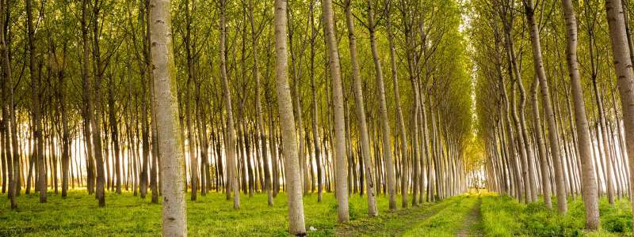
The Descent of Phaethon
The Poplars of Phaethon
Analysis was carried out on patterns in pollen levels, which suggested pine forests were suddenly burned off to be replaced by poplar trees – a species specializing in covering barren ground, as you might get when your planet has been hit by a series of massive fireballs.
Recall that in the myth of Phaethon, his sisters, the Heliades, are turned to black poplar trees as they mourn his death, caused from crashing into the Earth.
https://www.sciencealert.com/a-firestorm-bigger-than-the-one-that-killed-the-dinosaurs-triggered-an-ice-age-13-000-years-ago

Slide 37
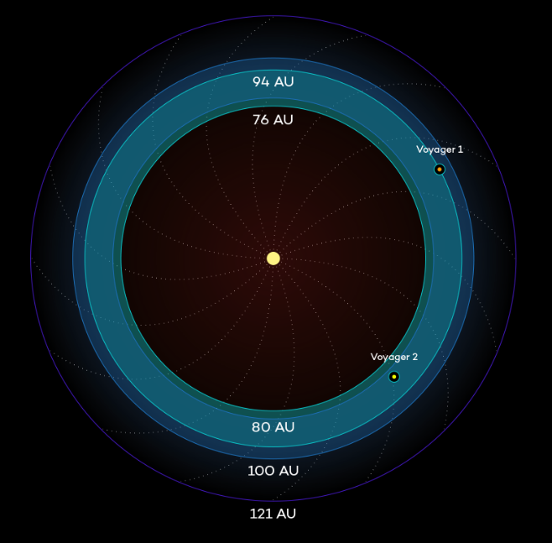
The Descent of Phaethon
The Heliosphere
The heliosphere is the magnetosphere, astrosphere and outermost atmospheric layer of the Sun. It takes the shape of a vast, bubble-like region of space. In plasma physics terms, it is the cavity formed by the Sun in the surrounding interstellar medium.
The "bubble" of the heliosphere is continuously "inflated" by plasma originating from the Sun, known as the solar wind. Outside the heliosphere, this solar plasma gives way to the interstellar plasma permeating the Milky Way.
As part of the interplanetary magnetic field, the heliosphere shields the Solar System from significant amounts of cosmic ionizing radiation; uncharged gamma rays are, however, not affected.
https://en.wikipedia.org/wiki/Heliosphere

Slide 38
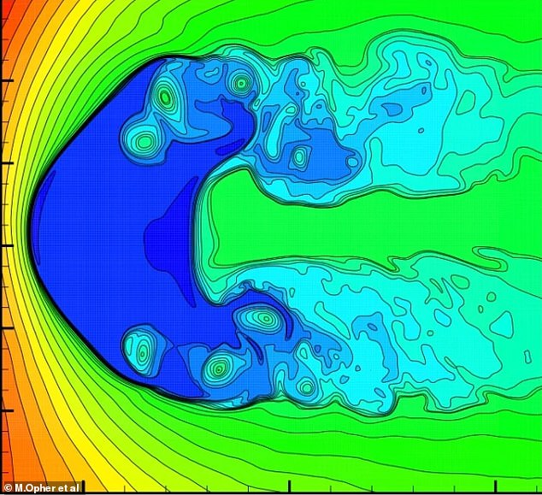
The Descent of Phaethon
The Heliosphere
Recent analysis of the heliosphere found that twin jets of material – known as heliospheric jets – emanate from the sun's poles. But rather than shooting straight out, they curve round to form the solar system's tails and look like the points of a croissant.
A study led by Boston University has found the reason why this heliosphere has taken this shape is due to neutral hydrogen particles from interstellar space.
These particles make the heliospheric jets unstable and cause them to bend inwards.
https://www.dailymail.co.uk/sciencetech/article-10280117/The-solar-shaped-like-croissant.html

Slide 39
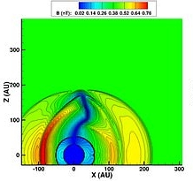
The Descent of Phaethon
The Heliosphere
Using a computer model, researchers found that when the neutral hydrogen particles were taken out of the simulation, the jets coming from the sun became “super stable”.
But when they were put back, the heliospheric jets became very unstable again.
The researchers claim this happens because of the interaction of the neutral hydrogen particles with the ionized matter in the heliosheath — the outer region of the heliosphere.
https://www.dailymail.co.uk/sciencetech/article-10280117/The-solar-shaped-like-croissant.html

Slide 40
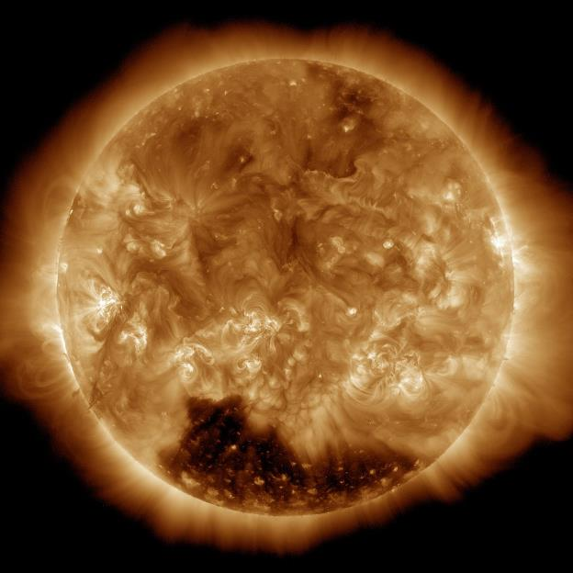
The Descent of Phaethon
The Heliosphere
The instability of the heliosphere is an indicator that the Sun was “damaged” in some way, and this damage altered or weakened its heliosphere.
This weakened heliosphere is unable to property shield the solar system from the massive amounts of neutral hydrogen particles from interstellar space.
This, in turn, makes the damaged heliosphere even more unstable.
https://www.dailymail.co.uk/sciencetech/article-10280117/The-solar-shaped-like-croissant.html

Slide 41
The Descent of Phaethon
The Heliosphere
Because of the damage to the Sun and its heliosphere, the Earth would have been exposed to much lower levels of interstellar/solar radiation prior to this cataclysm (antediluvian). Much lower (and more stable) than it does currently.
Another indicator of possible damage to the Sun, is the antediluvian average orbital radius of Earth. This orbital period places the Earth closer to the Sun.
https://www.dailymail.co.uk/sciencetech/article-10280117/The-solar-shaped-like-croissant.html

Slide 42
The Descent of Phaethon
The Heliosphere
If the Earth's average orbital radius was still at this distance, average global temperatures would rise significantly. In other words, the Earth would be extremely “hot”.
This indicates that the Sun once produced lower (different) levels of various types of radiation.
https://www.dailymail.co.uk/sciencetech/article-10280117/The-solar-shaped-like-croissant.html

Slide 43
The Descent of Phaethon
The Heliosphere
One possible explanation for this damage to the Sun is that a very large object (such as a planet) fell into the Sun.
If this object contained significant amounts of any heavy elements (such as iron), the Sun would have most likely “ejected” it outwards, along with large amounts of the Sun’s plasma.
This “ejection” would have been in the form of a massive explosion emanating from the Sun.
The scale of the damage (or destruction) inflicted on objects orbiting the Sun during this explosion would depend on the size of this explosion (its total energy).
https://www.dailymail.co.uk/sciencetech/article-10280117/The-solar-shaped-like-croissant.html

Slide 44

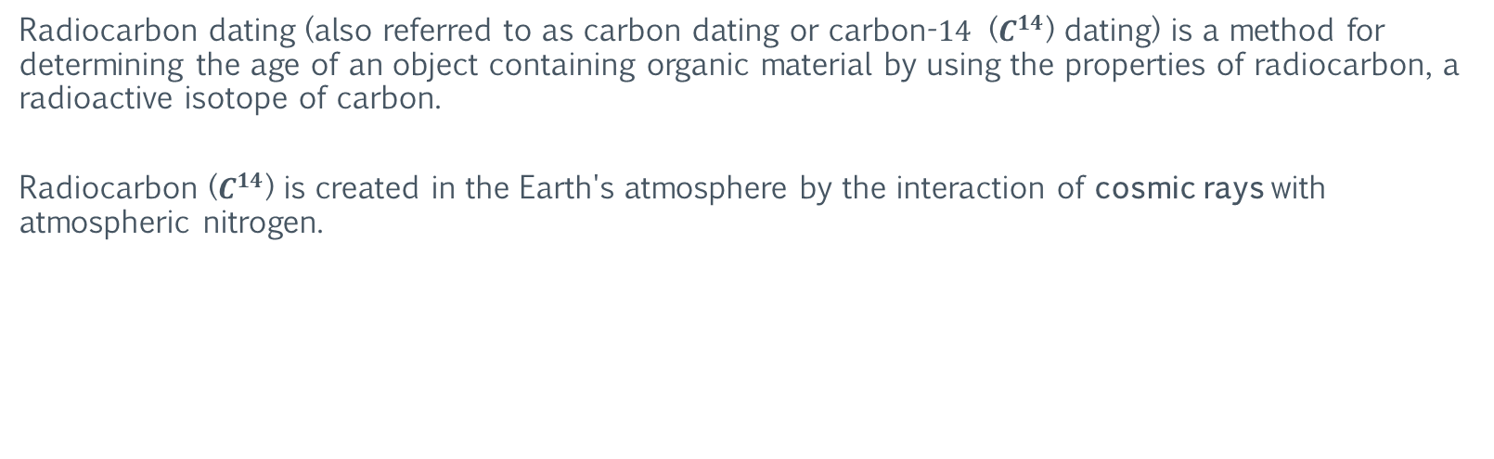
The Descent of Phaethon
Radiocarbon Dating
Radiocarbon dating (also referred to as carbon dating or carbon-$14$ ($C^{14}$) dating) is a method for determining the age of an object containing organic material by using the properties of radiocarbon, a radioactive isotope of carbon.
Radiocarbon ($C^{14}$) is created in the Earth's atmosphere by the interaction of cosmic rays with atmospheric nitrogen.
https://en.wikipedia.org/wiki/Radiocarbon_dating

Slide 45
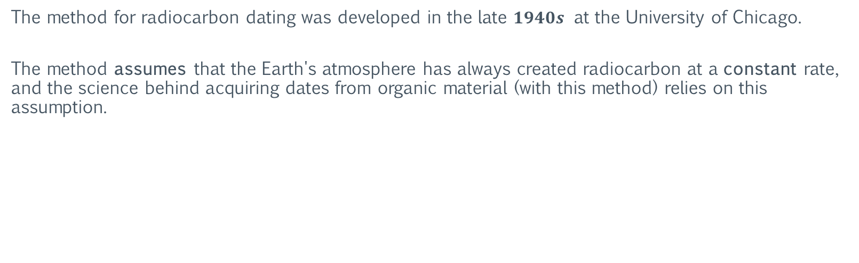
The Descent of Phaethon
Radiocarbon Dating: The Assumption
The method for radiocarbon dating was developed in the late $1940s$ at the University of Chicago.
The method assumes that the Earth's atmosphere has always created radiocarbon at a constant rate, and the science behind acquiring dates from organic material (with this method) relies on this assumption.
https://en.wikipedia.org/wiki/Radiocarbon_dating

Slide 46

The Descent of Phaethon
Radiocarbon Dating: The Assumption
The logic behind this assumption is as follows:
If the state of an observed system does not change during observation, then state of the system must therefore have always existed in the observed state.
This is obviously flawed logic. Furthermore, there is no evidence to support this assumption.
https://en.wikipedia.org/wiki/Radiocarbon_dating

Slide 47

The Descent of Phaethon
Radiocarbon Dating: The Dependency Tree
Scientists use the dates returned by radiocarbon dating to establish the age of objects as well as the timeline of human history.
The dates are also frequently used to “calibrate” the results of other radiocarbon dating. Some dates are calibrated against other methods of dating, such as the counting of rings in the cross-section of tree specimens.
However, many of the dates, though independently radiocarbon tested, are subject to a long lineage of dependencies (dependency tree).
https://en.wikipedia.org/wiki/Radiocarbon_dating

Slide 48

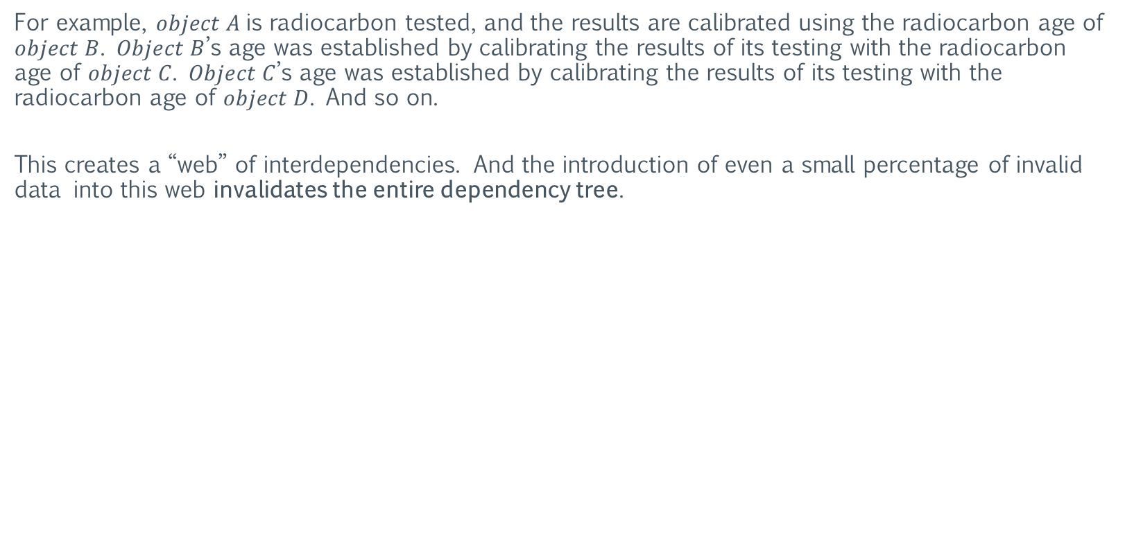
The Descent of Phaethon
Radiocarbon Dating: The Dependency Tree
For example, $object A$is radiocarbon tested, and the results are calibrated using the radiocarbon age of $object B$. $Object B$’s age was established by calibrating the results of its testing with the radiocarbon age of $object C$. $Object C$’s age was established by calibrating the results of its testing with the radiocarbon age of $object D$. And so on.
This creates a “web” of interdependencies. And the introduction of even a small percentage of invalid data into this web invalidates the entire dependency tree.
https://en.wikipedia.org/wiki/Radiocarbon_dating

Slide 49
The Descent of Phaethon
Radiocarbon Dating: Sample Contamination
Additionally, exposure to high levels of radiation can contaminate (or damage) a radiocarbon dating sample. Samples contaminated by radiation will generally return smaller age values when radiocarbon tested.
That is, the results of the radiocarbon testing will indicate (incorrectly) that the sample is “younger” than it is.
And in many cases, contaminated samples have returned negative values for the sample’s age.
https://en.wikipedia.org/wiki/Radiocarbon_dating

Slide 50
The Descent of Phaethon
Radiocarbon Dating: Sample Contamination
In other words, the results of the radiocarbon testing indicated that the sample originated from a date in the future. This is usually how a contaminated sample is recognized. However, not all contaminated samples will return a future date.
Therefore, without an obvious red flag (such as a future date), many contaminated samples can potentially go unnoticed.
https://en.wikipedia.org/wiki/Radiocarbon_dating

Slide 51
The Descent of Phaethon
Radiocarbon Dating: Sample Contamination
The most extreme cases of sample contamination occur near nuclear test sites (or any location where a nuclear device was detonated).
However, samples contaminated via radiation are not confined to the near proximity of nuclear detonations.
https://en.wikipedia.org/wiki/Cobalt_bomb

Slide 52
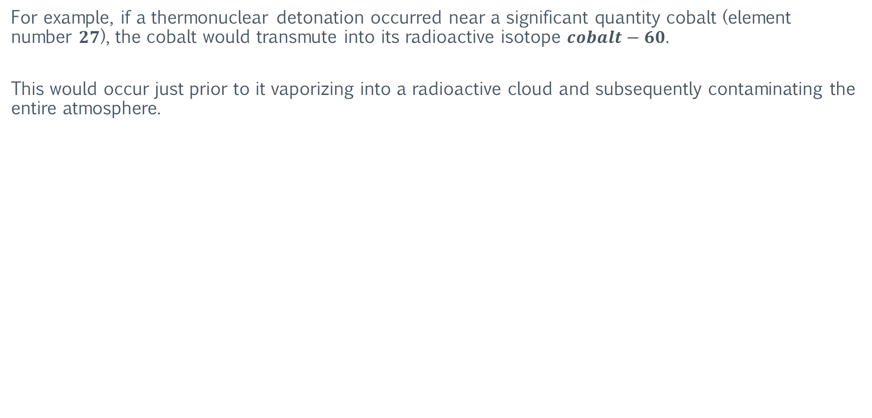
The Descent of Phaethon
Radiocarbon Dating: Sample Contamination
For example, if a thermonuclear detonation occurred near a significant quantity cobalt (element number $27$), the cobalt would transmute into its radioactive isotope $cobalt−60$.
This would occur just prior to it vaporizing into a radioactive cloud and subsequently contaminating the entire atmosphere.
https://en.wikipedia.org/wiki/Cobalt_bomb

Slide 53
The Descent of Phaethon
Radiocarbon Dating: Sample Contamination
The transmutation is the result of neutron bombardment of the cobalt. So, this reaction is not limited to just thermonuclear detonations.
The ingredients needed for this are cobalt, extreme heat, and neutrons. A large coronal mass ejection (CME) of plasma from the Sun could deliver the later two.
https://en.wikipedia.org/wiki/Coronal_mass_ejection

Slide 54
The Descent of Phaethon
Radiocarbon Dating: Sample Contamination
Note that natural cobalt is found almost exclusively in chemically combined form. This means the element must be “freed” via reductive smelting.
Cobalt is most usually produced as a bi-product of copper and nickel mining.
https://en.wikipedia.org/wiki/Cobalt

Slide 55

The Descent of Phaethon
Radiocarbon Dating: Scientific Validity
Given the overwhelming evidence presented in this series, it is apparent that there is an extreme disconnect between reality and the “accepted” timeline of human history (as dictated by archaeologists).
This alone demonstrates the invalidity of timelines established through radiocarbon dating.
The details provided in this section further highlight this fact, as well as provide possible causes for this erroneous data.
https://en.wikipedia.org/wiki/Radiocarbon_dating

Slide 56
The Descent of Phaethon
Radiocarbon Dating: Scientific Validity
Therefore, archaeological timelines established using the method of radiocarbon dating discussed in this section cannot be considered reliable, nor scientifically valid.
Furthermore, the continued use of this method to establish timelines can only be considered pseudoscience.
This is the consequence of a largely unchallenged false assumption.
https://en.wikipedia.org/wiki/Radiocarbon_dating

Slide 57
Section II: The Book of Revelation
The following section examines some of the details of the Book of Revelation and information possibly embedded within these details. The purpose is to illustrate the relationship of this embedded information with various aspects of antediluvian civilization(s). This is not intended to be a complete analysis of the Book of Revelation.

Slide 58
The Book of Revelation
Background
The Book of Revelation – also called the Apocalypse of John is the final book of the New Testament and consequently is also the final book of the Christian Bible. The Book of Revelation is the only apocalyptic book in the New Testament canon.
The author names himself as "John" in the text, but his precise identity remains a point of academic debate. Second-century Christian writers such as Papias of Hierapolis, Justin Martyr, Irenaeus, Melito of Sardis, Clement of Alexandria, and the author of the Muratorian fragment identify John the Apostle as the "John" of Revelation.
Modern scholarship generally takes a different view, with many considering that nothing can be known about the author except that he was a Christian prophet. Modern theological scholars characterize the Book of Revelation's author as "John of Patmos". The bulk of traditional sources date the book to the reign of the Roman emperor Domitian (AD 81–96), which evidence tends to confirm.
The original text of the Book of Revelation was written in Greek. The same is true of the works of Plato.
https://en.wikipedia.org/wiki/Book_of_Revelation

Slide 59

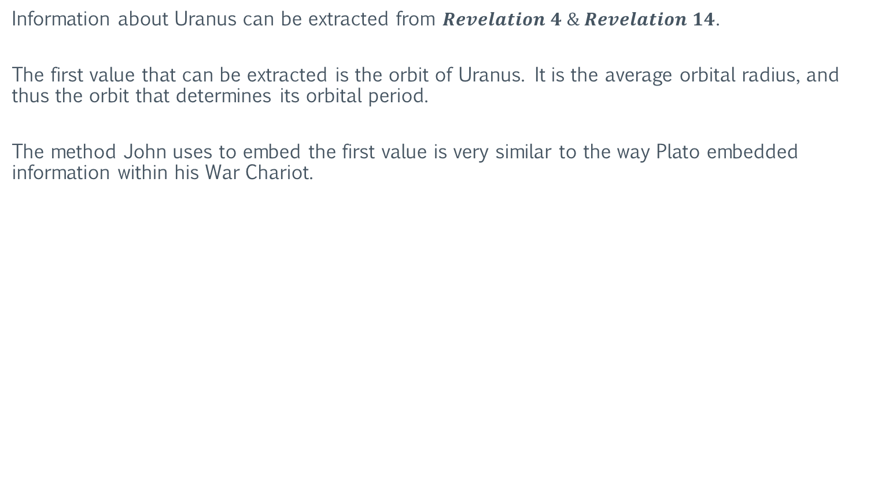
The Book of Revelation
Uranus
Information about Uranus can be extracted from $Revelation 4 \& Revelation 14$.
The first value that can be extracted is the orbit of Uranus. It is the average orbital radius, and thus the orbit that determines its orbital period.
The method John uses to embed the first value is very similar to the way Plato embedded information within his War Chariot.
https://en.wikipedia.org/wiki/Book_of_Revelation

Slide 60
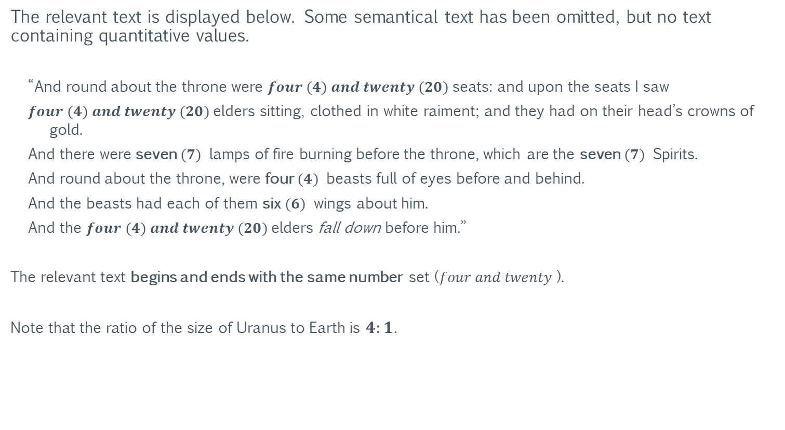
The Book of Revelation
Uranus
The relevant text is displayed below. Some semantical text has been omitted, but no text containing quantitative values.
“And round about the throne were $four (4) and twenty (20)$seats: and upon the seats I saw
$four (4) and twenty (20)$elders sitting, clothed in white raiment; and they had on their head’s crowns of gold.
And there were seven $(7)$ lamps of fire burning before the throne, which are the seven $(7)$ Spirits.
And round about the throne, were four $(4)$ beasts full of eyes before and behind.
And the beasts had each of them six $(6)$ wings about him.
And the $four (4) and twenty (20)$elders fall down before him.”
The relevant text begins and ends with the same number set ($four and twenty$).
Note that the ratio of the size of Uranus to Earth is $4:1$.
https://en.wikipedia.org/wiki/Book_of_Revelation

Slide 61
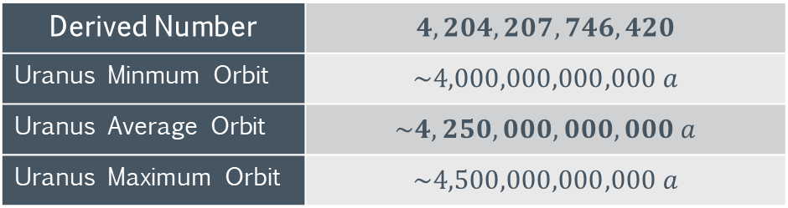
The Book of Revelation
Uranus
The table below shows the derived number and the orbital information of Uranus.
Derived Number | $$4,204,207,746,420$$
$$\text{Uranus} \text{Minmum} \text{Orbit}$$ | $$\sim 4,000,000,000,000 a$$
$$\text{Uranus} \text{Average} \text{Orbit}$$ | $$\sim 4,250,000,000,000 a$$
$$\text{Uranus} \text{Maximum} \text{Orbit}$$ | $$\sim 4,500,000,000,000 a$$
https://en.wikipedia.org/wiki/Book_of_Revelation

Slide 62
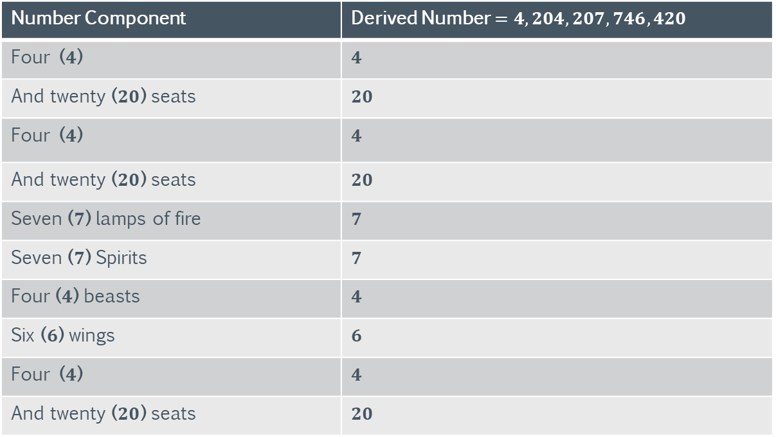
The Book of Revelation
Uranus
The table below shows how the number is derived.
Number Component | Derived Number $=4,204,207,746,420$
Four ($4$) | $$4$$
And twenty ($20$) seats | $$20$$
Four ($4$) | $$4$$
And twenty ($20$) seats | $$20$$
Seven ($7$) lamps of fire | $$7$$
Seven ($7$) Spirits | $$7$$
Four ($4$) beasts | $$4$$
Six ($6$) wings | $$6$$
Four ($4$) | $$4$$
And twenty ($20$) seats | $$20$$
https://en.wikipedia.org/wiki/Book_of_Revelation

Slide 63
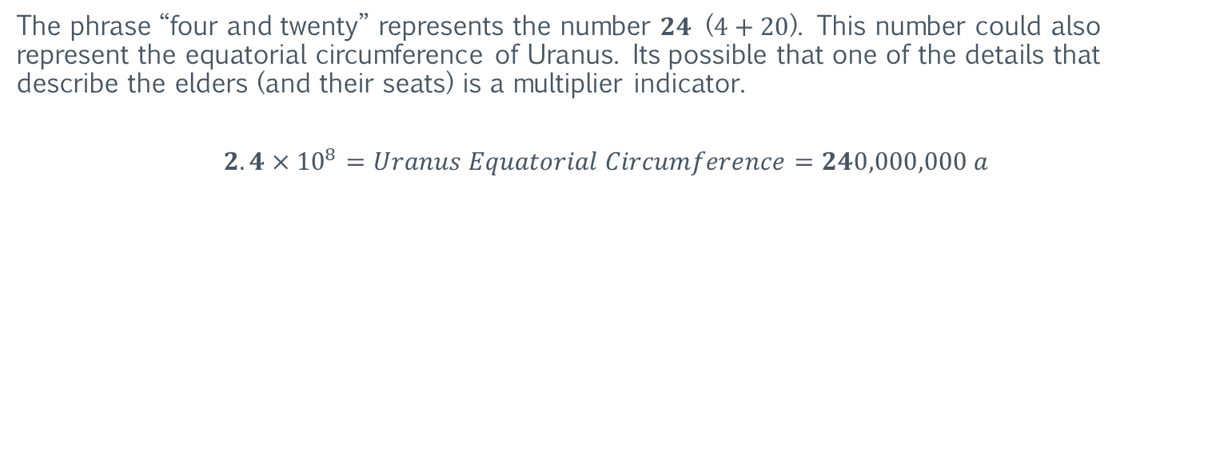
The Book of Revelation
Uranus
The phrase “four and twenty” represents the number $24$ ($4+20$). This number could also represent the equatorial circumference of Uranus. Its possible that one of the details that describe the elders (and their seats) is a multiplier indicator.
$$2.4×{10}^{8}=Uranus Equatorial Circumference=240,000,000 a$$
https://en.wikipedia.org/wiki/Book_of_Revelation

Slide 64
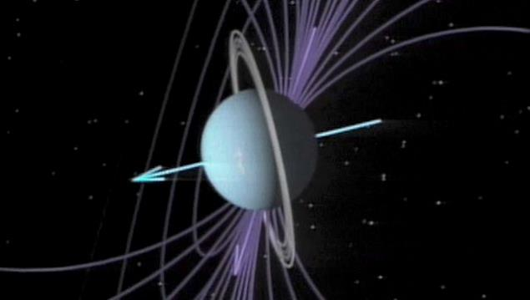
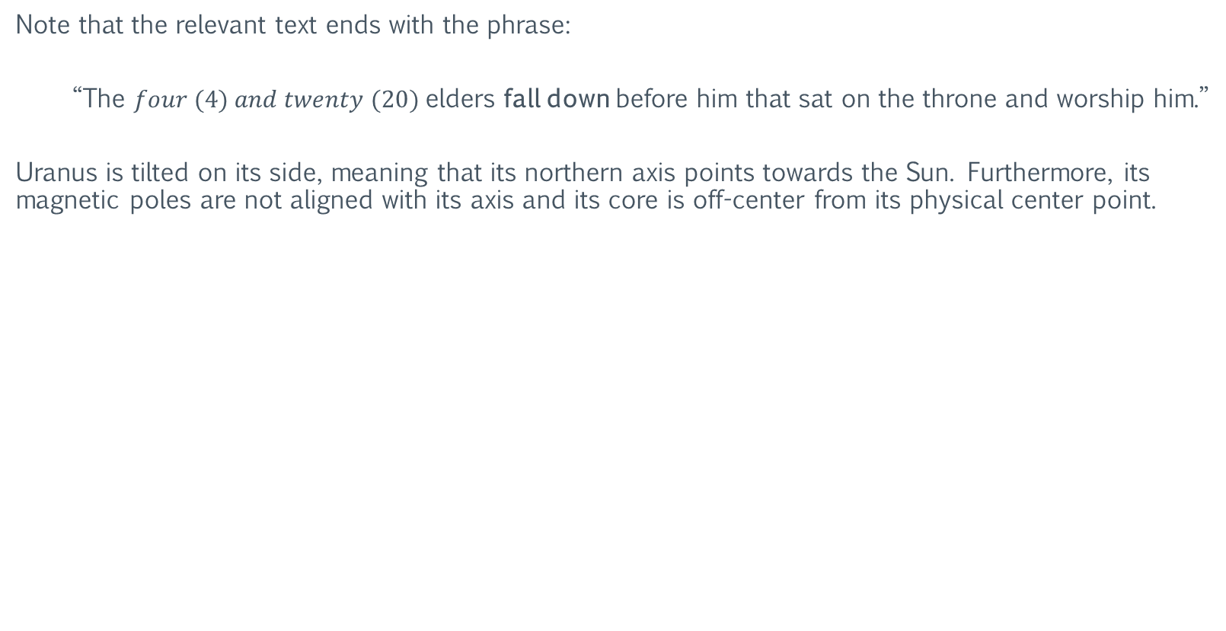
The Book of Revelation
Uranus
Note that the relevant text ends with the phrase:
“The $four (4) and twenty (20)$elders fall down before him that sat on the throne and worship him.”
Uranus is tilted on its side, meaning that its northern axis points towards the Sun. Furthermore, its magnetic poles are not aligned with its axis and its core is off-center from its physical center point.
https://en.wikipedia.org/wiki/Uranus

Slide 65

The Book of Revelation
Uranus
$Revelation 14:1$states.
“And I looked, and, lo, a Lamb stood on the mount Sion, and with him a hundred forty and four thousand ($144,000$)…”
The value for the Moon’s orbit is $144,000$ when using the circumference-based sexagesimal system of Uranus. This system has a calibration value of $15,000,$ which is also the calibration value of the Ishtar Anunnaki System.
Note that the minimum orbital radius of Neptune and Pluto is $1.666×{10}^{12}$ in the Uranus system. This represents the maximum orbit of Mars, which is $1.666$astronomical units (au) .
And using the sexagesimal system of Mars, the equatorial circumference of Uranus is $450,000,000$. This value is equal to the speed of light, and it also represents the maximum orbital radius of Uranus (in ants).
https://en.wikipedia.org/wiki/Book_of_Revelation

Slide 66

The Book of Revelation
Uranus: The Cataclysm
Given the context that this information is presented within (the only apocalyptic book in the New Testament ), it appears that Uranus participated in a cataclysm that most likely affected the entire solar system.
Furthermore, it appears this cataclysm involved extremely high amounts of energy (kinetic or otherwise). Enough to knock the core of Uranus off-center.
Therefore, it is likely that the Book of Revelation is describing one or more cataclysms that have already occurred, as opposed to “predicting” a cataclysm that is supposed to occur at some point in the future.
https://en.wikipedia.org/wiki/Uranus

Slide 67


The Book of Revelation
Mars: The Wounded Head
$Revelation 13:3$states.
“And I saw one of his heads as it were wounded to death; and his deadly wound was healed: and all the world wondered after the beast.”
This could be a reference to Mars. A giant canyon-like structure stretches across the face of Mars and resembles a scar. It is known as the Valles Marineris.
Theories on how this structure formed vary wildly, and currently there is no real consensus regarding its formation.
https://en.wikipedia.org/wiki/Valles_Marineris

Slide 68


The Book of Revelation
Mars: The Winepress
$Revelation 14:20$states.
“And the winepress was trodden without the city, and blood came out of the winepress, even unto the horse bridles, by the space of a thousand and six hundred ($1,600$) stadia.”
Recall that the orbital radius of the “potential” co-orbital partner of Mars is $1.600×{10}^{9} a.$ So, this could be a reference to an event that involved Mars and/or its co-orbital partner.
https://en.wikipedia.org/wiki/Book_of_Revelation

Slide 69


The Book of Revelation
Mars: The Winepress
However, $Papyrus 115$, the oldest preserved manuscript of the Book of Revelation as of $2017$, gives the number $2,600$, as opposed to $1,600$.
“And the winepress was trodden without the city, and blood came out of the winepress, even unto the horse bridles, by the space of two thousand and six hundred ($2,600$) stadia.”
Note that the polar radius of the Moon is $2,600 ka$.
https://en.wikipedia.org/wiki/Papyrus_115

Slide 70

The Book of Revelation
Venus
$Revelation 12:1$states.
“And there appeared a great wonder in heaven; a woman arrayed with the Sun, and the Moon under her feet.”
This could represent Venus, as planets are arrayed with the sun (or clothed by its light). The phrase “the Moon under her feet” could be a reference to (or related to) a circular structure located near the center of Atlantis.
https://en.wikipedia.org/wiki/Book_of_Revelation

Slide 71
The Book of Revelation
Venus
The images below show this structure. This structure resembles the face of the Moon. Note that it is located directly under the orbital projection of Venus (under her feet).
Orbital Zone of Venus
Orbital Zone of Venus
https://en.wikipedia.org/wiki/Book_of_Revelation

Slide 72


The Book of Revelation
Alpha and Omega
In ancient Mesopotamian religion, Anu is the divine personification of the sky, supreme god, and ancestor of all the Anunnaki. Anu represents the numbers one ($1$) and sixty ($60$).
Anu was believed to be the supreme source of all authority, for the other gods and for all mortal rulers, and he is described in one text as the one "who contains the entire universe".
Anu
https://en.wikipedia.org/wiki/Book_of_Revelation

Slide 73



The Book of Revelation
Alpha and Omega
The Book of Revelation mentions the following phrase several times:
“I am Alpha and Omega, the beginning and the ending”
The phrase occurs in $Revelation 1:8$, $Revelation 1:11$, $Revelation 21:6,$and $Revelation 21:13$.
In the Greek alphabet, alpha is the $1st$ letter and omega is the $24th$ and last letter.
Anu represents the numbers one ($1$) and sixty ($60$). The number one ($1$) is the first of the “sacred’ numbers for the Anunnaki, and sixty ($60$) is the last.
In addition, the numbers one ($1$) and sixty ($60$) are the first and last base numbers in the sexagesimal number system.
$$ΑΩ$$
https://en.wikipedia.org/wiki/Book_of_Revelation

Slide 74

The Book of Revelation
Alpha and Omega
The radius-based calibration value for the number $1$ is ${10}^{n}×6.3$, where $n = number of decimal places$.
For example, when $n=7,$ the radius-based calibration value equals $63,000,000$ ($10,000,000×6.3$). This equals the calibration value of the sacred cubit.
Therefore, Anu shares this Anunnaki System (calibration value) with the deity Adad (the number $10$).
$$ΑΩ$$
https://en.wikipedia.org/wiki/Anu

Slide 75

The Book of Revelation
Alpha and Omega
$Revelation 13:11$ describes a beast that has two ($2$) horns. This could be a reference to the two ($2$) numbers represented by Anu.
$Revelation 13:12$ states that this beast “exercised all the authority of the first beast before him”. The first beast in $Chapter 13$is described as having ten crowns (the number $10$).
The “relationship” of these two beasts is very similar to the relationship between the Anunnaki Systems of Anu and Adad. For example, the two systems share the calibration value of the sacred cubit ($63,000,000$).
In other words, the Anu system has all the possible calibration values (authority) of Adad, plus an additional set based on the number $60$.
$$ΑΩ$$
https://en.wikipedia.org/wiki/Anu

Slide 76

The Book of Revelation
Alpha and Omega
The Book of Revelation mentions the “One” several times. The table below displays the location and text of some of the references to the “One”.
Verse | Text
$$Revelation 1:8$$ | $\text{"}\text{I} \text{am} \text{the} \text{One} \text{who} \text{is}\text{, }\text{who} \text{always} \text{was}\text{, }\text{and} \text{who} \text{is} \text{still} \text{to} \text{come}\text{−−}\text{the} \text{Almighty} \text{One}$.”
$$Revelation 1:18$$ | $\text{"}\text{I} \text{am} \text{the} \text{Living} \text{One}\text{; }\text{I} \text{was} \text{dead}\text{, }\text{and} \text{now} \text{look}\text{, }\text{I} \text{am} \text{alive} \text{for} \text{ever} \text{and} \text{ever}$.”
$$Revelation 4:2$$ | $\text{"}\text{And} \text{immediately} \text{I} \text{was} \text{in} \text{the} \text{spirit}\text{: }and \text{behold}\text{, }\text{a} \text{throne} \text{was} \text{set} \text{in} \text{heaven}\text{, }\text{and} \text{One} \text{sat} \text{on} \text{the} \text{throne}$”
$$Revelation 17:10$$ | $\text{"}\text{And} \text{there} \text{are} \text{seven} \text{kings}\text{: }\text{five} \text{are} \text{fallen}\text{, }\text{and} \text{One} \text{is}\text{, }\text{and} \text{the} \text{other} \text{is} \text{not} \text{yet} \text{come}\text{; }\text{and} \text{when} \text{he} \text{cometh}\text{, }\text{he} \text{must} \text{continue} \text{a} \text{short} \text{space}\text{.}$”
$$Revelation 13:18$$ | $\text{"}\text{let} \text{the} \text{One} \text{who} \text{has} \text{understanding} \text{calculate} \text{the} \text{number} \text{of} \text{the} \text{beast}\text{, }\text{for} \text{it} \text{is} \text{the} \text{number} \text{of} \text{a} \text{man}\text{, }\text{and} \text{his} \text{number} \text{is}$666.”
https://en.wikipedia.org/wiki/Book_of_Revelation

Slide 77


The Book of Revelation
Shamash: The Army of the Horsemen
$Revelation 9:16$states:
“And the number of the army of the horsemen were two hundred thousand-thousand ($200,000,000$): and I heard the number of them.”
This number represents the calibration value of the Shamash ($20$) Anunnaki System.
Anunnaki | Number | Calibration Value (Circumference-Based)
$$\text{Shamash}$$ | $$20$$ | $$200,000,000$$
https://en.wikipedia.org/wiki/Book_of_Revelation

Slide 78


The Book of Revelation
Shamash: The Army of the Horsemen
With the Shamash Anunnaki System, every orbital radius of every object in the solar system has a value that is exactly equal (numerically) to its P-Ratio. This is because its P-Ratio divisor is $100,000,000$ ($1$).
The table below displays an example of this.
Orbit | Shamash ($200,000,000$) | P-Ratio
$$\text{Venus} \text{Minmum} \text{Orbit}$$ | $$536,420,626,295 sh$$ | $$5.36420626295 pr$$
$$\text{Venus} \text{Average} \text{Orbit}$$ | $$540,156,145,977 sh$$ | $$5.40156145977 pr$$
$$\text{Venus} \text{MaximumOrbit}$$ | $$543,891,665,659 sh$$ | $$5.43891665659 pr$$
https://en.wikipedia.org/wiki/Book_of_Revelation

Slide 79



The Book of Revelation
Ereshkigal: The $7, 000$Slain
$Revelation 11:13$states
“…and in the earthquake were slain of men seven thousand ($7,000$): and the remnant were affrighted and gave glory to the God of heaven.”
This number represents the Ereshkigal ($7$) Anunnaki System.
Anunnaki | Number | Calibration Value (Circumference-Based) | Calibration Value (Radius-Based)
$$\text{Ereshkigal}$$ | $$7$$ | $$7,000,000$$ | $$44,100,000$$
Note that the polar radius of Uranus is exactly $7,000,000$ when the remainder of Plato’s War Chariot ($11,222,334$) is used as a calibration value.
$$Plato^{′}s War Chariot=222,011,222,334−222,000,000,000=11,222,334=remainder$$

Slide 80

The Book of Revelation
The Bottomless Pit
The term “bottomless pit” is used seven ($7$) times in the Book of Revelation. The term is used in reference to a beast ascending out of the pit and then subsequently being “cast” back into the pit, which is locked with a key.
Its possible that the bottomless pit is in reference to a mathematical symbol used to perform some calculation. For example, consider the hypothetical statement:
“And the beast of thirty-six crowns spent three days on the mountain top”.
In mathematics, the exponent symbol ($^$) resembles a mountain top. Using this imagery, it could be inferred that the intention of the above hypothetical statement is to perform a calculation by raising thirty-six to the power of three ($36^3=46,656$).
So, there may be an “ancient” mathematical symbol that is no longer used that visually resembles some sort of hole with no bottom. The symbols below are an example of how a mathematical symbol could resemble a bottomless pit. These are just examples and have no relevant meaning.
$$\bigcup{=pit} \bigcap{=bottomless pit}$$
https://en.wikipedia.org/wiki/Book_of_Revelation

Slide 81

The Book of Revelation
The Bottomless Pit
An alternative is that the bottomless pit represents a black hole.
In addition to the obvious similarity of a hole and a pit, the observed behavior of an object falling into a black hole (from an external reference frame) is conceptually equivalent to an object falling into a pit with no bottom.
In other words, if an observer witnesses an object falling into a black hole, from the perspective of the observer, the object will never reach the “bottom” (core) of the black hole. This is because the object will appear to “freeze” in time as it crosses the event horizon of the black hole.
Therefore, from the perspective of this observer, a black hole is effectively a bottomless pit.
The Bottomless Pit
https://en.wikipedia.org/wiki/Black_hole

Slide 82

The Book of Revelation
The Bottomless Pit
Recall that Anu is referred to as the one "who contains the entire universe“. In addition, the first number he represents is the number one ($1$).
This is an accurate description of a singularity. The entire universe is theorized to have existed within such a singularity just “prior” to the Big Bang.
Therefore, Anu can possibly represent the singularity of the universe, the singularity of a black hole, or both.
The last of the three ($3$) possibilities in an indication that the first two ($2$) are one ($1$) in the same.
The Bottomless Pit
https://en.wikipedia.org/wiki/Big_Bang

Slide 83

The Book of Revelation
The Six Wings of the Beasts
$Revelation 4:8$ states:
“And the four beasts had each of them six ($6$) wings about him; and they were full of eyes within: and they rest not day and night.”
There is another reference to objects having six ($6$) wings in $Isaiah 6:2$, which states:
“Above it stood the seraphims: each one had six ($6$) wings; with twain he covered his face, and with twain he covered his feet, and with twain he did fly.”
A seraphim is an angelic being (angel), regarded in traditional Christian angelology as belonging to the highest order of the ninefold ($9$) celestial hierarchy.
https://en.wikipedia.org/wiki/Book_of_Revelation

Slide 84


The Book of Revelation
The Six Wings of the Beasts
A wing is a modified forelimb that bears large feathers and is used for flying.
A wing can also be a lateral part or projection of an organ or structure.
For example, the octahedral geometric structure pictured to the right has six ($6$) projections (wings) protruding from its center point.
Note that this structure can be described as having four ($4$) faces and two ($2$) heads (and/or two ($2$) sets of feet).
Head
Foot
Face
Face
Face
Face
Head
Foot
Octahedral Structure
https://en.wikipedia.org/wiki/Octahedral_molecular_geometry

Slide 85


The Book of Revelation
The Six Wings of the Beasts
In geometry, an octahedron (plural: octahedra, octahedrons) is a polyhedron with eight ($8$) faces, twelve ($12$) edges, and six vertices ($6$).
The term is most used to refer to the regular octahedron, a Platonic solid composed of eight ($8$) equilateral triangles, four ($4$) of which meet at each vertex.
An octahedron is a square bipyramid; in that it represents two ($2$) identical pyramids joined at their bases.
Octahedron
https://en.wikipedia.org/wiki/Octahedron

Slide 86


The Book of Revelation
The Anunnaki Calculation
A “natural” Anunnaki System is an object-bound system where its equatorial circumference (in ants) equals the calibration value of any of the Anunnaki Systems.
For example, the Earth’s equatorial circumference (antediluvian) is $60,000,000 ants.$ This binds Earth (the object) to the Anu ($60$) Anunnaki System. Using another system to measure its circumference will produce another numerical value for its circumference, but the Earth will always be $60,000,000 a$.
The measured size of the Earth may change slightly from time to time (after an ice age for example), but its effective size is static.
https://en.wikipedia.org/wiki/Book_of_Revelation

Slide 87

The Book of Revelation
The Anunnaki Calculation
A celestial object (planet, dwarf planet, etc.) that is bound to the Shamash ($20$) Anunnaki System would have an equatorial circumference of $2.00×{10}^{n} ants$. As a result, the object would have a sexagesimal system calibration value of $1.80×{10}^{n}.$
For example, a “hypothetical” moon (or dwarf planet) with a circumference of $20,000,000 ants$ ($n=7$) would have a sexagesimal system calibration value of $180,000,000 \text{(}n=8\text{)}$.
https://en.wikipedia.org/wiki/Book_of_Revelation

Slide 88

The Book of Revelation
The Anunnaki Calculation
This calibration value of $180,000,000$ creates an average orbital radius of Earth ($7.4 pr$) of exactly $666,000,000,000$.
Note the correlation of the number $666$ to $Revelation 13:18$, which states:
“Here is wisdom. Let him that hath understanding calculate the number of the beast: for it is the number of a man; and his number is Six hundred and sixty-six ($666$).”
https://en.wikipedia.org/wiki/Book_of_Revelation

Slide 89

The Book of Revelation
The Anunnaki Calculation
However, $Papyrus 115$, the oldest preserved manuscript of the Book of Revelation as of $2017$, gives the number $616$, as opposed to $666$.
Coincidently, the two varying digits (the $1$ and the $6$) represent the numbers of Anu ($1$ and $60$).
https://en.wikipedia.org/wiki/Papyrus_115

Slide 90

The Book of Revelation
The Anunnaki Calculation
All the unique measurement system calibration values applied to all the objects in the solar system creates a large dataset of values for object size and orbital distance.
Within this dataset, the number series “$666$” appears frequently, as well as all the other three ($3$) digit decimals with identical digits (i.e., $111, 222, 333, 444, 555, 666, 777, 888, and 999$). And they all occur at the same effective frequency (occurs about the same number of times for each series).
Examples of such occurrences are the average orbital radius of Earth ($222,000,000,000 a$) and the maximum orbital radius of Jupiter ($1,222,635,591,827 a$).
https://en.wikipedia.org/wiki/Book_of_Revelation

Slide 91

The Book of Revelation
The Anunnaki Calculation
Many of these occurrences are the product of the “simple” fractions with repeating decimal remainders created by the twelve ($12$) factors in sexagesimal number system. For example, $4/9=.444444$, $5/9=.555556$, and $2/3=.666667$.
However, many are not mathematical artifacts of a repeating decimal. They are the result of being a product of $3.7×{10}^{n}$.
Note that the cubit represents the length from the elbow to the tip of the middle finger (of a human) and the ratio of this length to the height of the measured individual is $3.7$.
https://en.wikipedia.org/wiki/Book_of_Revelation

Slide 92


The Book of Revelation
The Anunnaki Calculation
Recall that the average orbital radius of Earth is exactly $7.4 pr$, which is equal to $3.7×2.$ In addition, the minimum orbital radius of Jupiter is exactly $37 pr$. There are many calculated solar system object properties that derive their values in part from either the circumference of the Earth (which all P-Ratio’s derive from), or the orbital radius of Earth.
The product of sexagesimal derivatives of $60$ (such as $30$, $60$, $90$, $120$, $150$, $180$, etc.) and the numbers $3.7$ or $7.4$ produce non-repeating three ($3$) digit decimals (with identical digits). The table below demonstrates this mathematical phenomenon.
Number | $$×3.7$$ | $$×7.4$$
$$30$$ | $$30×3.7=111.00$$ | $$30×7.4=222.00$$
$$60$$ | $$60×3.7=222.00$$ | $$60×7.4=444.00$$
$$90$$ | $$90×3.7=333.00$$ | $$90×7.4=666.00$$
$$120$$ | $$120×3.7=444.00$$ | $$120×7.4=888.00$$
$$150$$ | $$150×3.7=555.00$$ | $$150×7.4=1,110.00$$
$$180$$ | $$180×3.7=666.00$$ | $$180×7.4=1,332.00$$

Slide 93

The Book of Revelation
The Anunnaki Calculation
Note that the product of $180$ and $7.4$ does not create non-repeating three ($3$) digit decimals (with identical digits).
Number | $$×3.7$$ | $$×7.4$$
$$180$$ | $$180×3.7=666.00$$ | $$180×7.4=1,332.00$$
In cases where the product is greater than three digits, a calculation can be performed that will keep reducing the product until there are only three digits remaining.

Slide 94




The Book of Revelation
The Anunnaki Calculation
To perform the calculation, split the target value into triplets reading frames, and then sum all the triplets together. Each triplet can have a value from $000$ to $999$.
Keep splitting into triplets and summing until the resulting sum is only three ($3$) digits (less than $1,000$).
The tables to the right demonstrate the standard Anunnaki Calculation.
The Anunnaki Calculation
$$180×7.4=1,332$$
$$1,332=001+332=333$$
The Anunnaki Calculation
$$324,000×7.4=2,397,600$$
$$2,397,600=002+397+600=999$$
The Anunnaki Calculation
$$1,620,859,165,020×7.4=11,994,357,821,148$$
$$11,994,357,821,148=011+994+357+821+148=2,331$$
$$2,331=002+331=333$$

Slide 95



The Book of Revelation
The Anunnaki Calculation
In addition to the standard calculation described above, “checksum” calculations can be performed by shifting the leading zeros ($0$’s) of the first triplet to the end of the last triplet.
If the first triplet does not have any leading zeros ($0$’s), pad the first triplet with a zero ($0$) and pad the last triplet with a trailing zero ($0$).
The tables below demonstrate the Anunnaki standard and checksum calculations.
The Anunnaki Standard Calculation
$$2,397,600=002+397+600=999$$
The Anunnaki Checksum Calculation
$$2,397,600=023+976+000=999$$
$$2,397,600=239+760+000=999$$

Slide 96


The Book of Revelation
The Anunnaki Calculation
The tables below demonstrate the Anunnaki standard and checksum calculations.
The Anunnaki Standard Calculation
$$11,994,357,821,148=011+994+357+821+148=2,331$$
$$2,331=002+331=333$$
The Anunnaki Checksum Calculation
$$11,994,357,821,148=001+199+435+782+114+800=2,331$$
$$2,331=002+331=333$$
$$11,994,357,821,148=119+943+578+211+480=2,331$$
$$2,331=002+331=333$$

Slide 97


The Book of Revelation
The Anunnaki Calculation: Plato’s War Chariot
Not all calculations from the Anunnaki Systems will result in a triplet with identical digits (such as $222$ or $444$). However, these exceptions still support checksum validation. In these cases, the checksum value will be a combination of three ($3$) digits. And each checksum will contain the same three ($3$) digits, but not necessarily in the same order.
The table below demonstrates standard and checksum calculations on one of these exceptions. Note that the target value is the same value as Plato’s War Chariot. Also note that the resulting three ($3$) digits are in numeric progression (sequential).
The Anunnaki Checksum Calculation
$$222,011,222,334=222+011+222+334=789$$
$$222,011,222,334=022+201+122+233+400=978$$
$$222,011,222,334=002+220+112+223+340=897$$
$$digits=7, 8, \& 9$$

Slide 98


The Book of Revelation
The Anunnaki Calculation: Plato’s War Chariot
The table below demonstrates standard and checksum calculations for just the “remainder” of Plato’s War Chariot. That is, $222,011,222,334−222,000,000,000=11,222,334=remainder.$ Note that the resulting three ($3$) digits are in numeric progression (sequential) as well.
The Anunnaki Checksum Calculation
$$11,222,334=011+222+334=567$$
$$11,222,334=001+122+233+400=756$$
$$11,222,334=112+223+340=675$$
$$digits=5, 6, \& 7$$

Slide 99


The Book of Revelation
The Anunnaki Calculation: Plato’s War Chariot
The table below displays the ratio of the remainder ($11,222,334$) to the average orbital radius of Earth ($222,000,000,000$). Note that the reduced denominator is the product of $3.7×{10}^{10}$.
Plato’s War Chariot
$$\frac{11,222,334}{222,000,000,000}=\frac{1,870,389}{37,000,000,000}$$
$$\frac{11,222,334}{6}=1,870,389$$
$$\frac{222,000,000,000}{6}=37,000,000,000$$

Slide 100
Section III: The Book of Life (DNA)
The following section examines some of the properties of the genetic code (DNA). These properties exhibit mathematical behavior that closely mirror the ant measurement system, the Anunnaki Calculation, and the P-Ratio. The purpose is the illustrate the mathematical and numerical relationships between DNA and various aspects of antediluvian civilization(s).

Slide 101

The Book of Life
“The beast that thou sawest was and is not; and shall ascend out of the bottomless pit and go into perdition: and they that dwell on the earth shall wonder, whose names were not written in the book of life from the foundation of the world, when they behold the beast that was, and is not, and yet is.
$$Revelation 21:27$$

Slide 102


The Book of Life
Acknowledgements
Much of the information contained in this section is taken directly from the research of Vladimir I. Shcherbak and Maxim A. Makukov.
In $2012$, Shcherbak and Makukov released a research paper titled “The ‘Wow! Signal’ of the terrestrial genetic code”.
The title is in reference to a famous anomalous signal detected early in the SETI project (the Search for Extra-Terrestrial Intelligence).
https://www.researchgate.net/publication/256719897_The_Wow_signal_of_the_terrestrial_genetic_code

Slide 103
The Book of Life
Acknowledgements
Their research examined the existing systems of organizing the genetic code. And building upon those systems, they found a “signal” (patterns and concepts) suggesting intelligence as well as the possibility of an embedded symbolic language.
This section will focus primarily on the existing systems of organizing the genetic code, but touches upon the “signal”.
Much of the text describing these systems is taken directly from the above-mentioned research paper.
However, some of the wording has been changed, so the relevant text will not be presented as direct quotes from said research material.
https://www.researchgate.net/publication/256719897_The_Wow_signal_of_the_terrestrial_genetic_code

Slide 104

The Book of Life
Genes and DNA
Genetics is the study of genes and tries to explain what they are and how they work. Genes are how living organisms inherit features or traits from their ancestors; for example, children usually look like their parents because they have inherited their parents' genes.
Genetics tries to identify which traits are inherited and explain how these traits are passed from generation to generation.
https://en.wikipedia.org/wiki/Introduction_to_genetics

Slide 105
The Book of Life
Genes and DNA
Genes are made from a long molecule called DNA, which is copied and inherited across generations. DNA is made of simple units that line up in a particular order within this large molecule. The order of these units carries genetic information, like how the order of letters on a page carries information.
The language used by DNA is called the genetic code, which lets organisms read the information in the genes. This information is the instructions for constructing and operating a living organism.
https://en.wikipedia.org/wiki/Introduction_to_genetics

Slide 106


The Book of Life
The Genetic Code
The genetic code is the set of rules used by living cells to translate information encoded within genetic material (DNA or mRNA sequences of nucleotide triplets, or codons) into proteins.
Translation is accomplished by the ribosome, which links proteinogenic amino acids in an order specified by messenger RNA (mRNA), using transfer RNA (tRNA) molecules to carry amino acids and to read the mRNA three ($3$) nucleotides at a time.
https://en.wikipedia.org/wiki/Genetic_code

Slide 107


The Book of Life
The Standard Genetic Code
The genetic code is highly similar among all organisms and can be expressed in a simple table with $64$ entries (codons).
The image to the right shows this table. This is the “standard” or “universal” code.
The Standard Genetic Code
https://www.researchgate.net/publication/256719897_The_Wow_signal_of_the_terrestrial_genetic_code

Slide 108
The Book of Life
The Contracted Genetic Code
The image to the right illustrates the “contracted code”.
This is the standard genetic code with “redundancies” removed.
https://www.researchgate.net/publication/256719897_The_Wow_signal_of_the_terrestrial_genetic_code

Slide 109

The Book of Life
Rumer’s Bisection
Yury Borisovich Rumer ($1966$) bisected the code by redundancy.
There are $8$ whole families and $8$ split families in the code.
Rumer found that codons in these families are mapped to each other in a one-to-one fashion with a simple relation:
$T⟷G$, $C⟷A$,
This is now known as Rumer’s transformation.
Rumer’s Bisection
https://www.researchgate.net/publication/256719897_The_Wow_signal_of_the_terrestrial_genetic_code

Slide 110

The Book of Life
Rumer’s Bisection
There are two more transformations of such type:
$T⟷C$, $A⟷G$
$T⟷A$, $C⟷G$
They also appear in Rumer’s bisection, and each makes half of what Rumer’s transformation makes alone.
Rumer’s Bisection
https://www.researchgate.net/publication/256719897_The_Wow_signal_of_the_terrestrial_genetic_code

Slide 111
The Book of Life
Rumer’s Bisection
The image below illustrates a common Rumer’s transformation with the nucleon and amino acid sums in decimal “format”.
https://www.researchgate.net/publication/256719897_The_Wow_signal_of_the_terrestrial_genetic_code

Slide 112

The Book of Life
Amino Acid Nucleons
Masami Hasegawa and Takashi Miyata ($1980$) arranged amino acids in order of increasing nucleon number which, unlike other amino acid properties, does not rely on arbitrarily chosen system of units.
The image below shows this arrangement. Note the repetitive occurrence of the number $74$ ($Earth average orbit= 7.4 pr$). Also note the proline transfer of $42−1=41$ ($41 pr=Jupiter Max Orbit$).
https://www.researchgate.net/publication/256719897_The_Wow_signal_of_the_terrestrial_genetic_code

Slide 113

The Book of Life
Decimalism
Arithmetical patterns should hold true in any numeral system ($base−10$, $base−12,$ etc.). However, as it turns out, when expressed in positional decimal system ($base−10$), the genetic code acquires a conspicuously distinctive (and familiar) notation.
The image below shows a portion of the genetic code expressed in positional decimal system ($base−10$). Note the occurrence of triplets with identical digits ($111$, $222$, etc.).
https://www.researchgate.net/publication/256719897_The_Wow_signal_of_the_terrestrial_genetic_code

Slide 114

The Book of Life
Decimalism
The genetic code (in positional decimal system) exhibits the digital symmetry of decimals divisible by $037$.
$$37 pr=Jupiter Minimum Orbit$$
$$3.7×2=7.4 pr=Earth Averge Orbit$$
Leading zero emphasizes its equal participation in the symmetry.
https://www.researchgate.net/publication/256719897_The_Wow_signal_of_the_terrestrial_genetic_code

Slide 115

The Book of Life
Decimalism
All three-digit decimals with identical digits ($111$, $222$, $333$, $444$, $555$, $666$, $777$, $888$, and $999$) are divisible by $037$.
In addition, the sum of three identical digits gives the quotient of the number divided by $037$.
Note that the cubit represents the length from the elbow to the tip of the middle finger (of a human) and the ratio of this length to the height of the measured individual is $3.7$.
https://www.researchgate.net/publication/256719897_The_Wow_signal_of_the_terrestrial_genetic_code

Slide 116

The Book of Life
Decimalism and the Anunnaki Calculation
Analogous sum for numbers with unique digits gives the central quotient in the column. Digits in these numbers are interconnected with cyclic permutations that are mirror symmetrical in neighbor columns. Addition instead of division provides an efficient way to perform checksums.
The scheme extends to decimals with more than three digits, if they are represented as $a + 999×n$, where $n$ is the quotient of the number divided by $999$ and a is the remainder, to which the same symmetry then applies (for three-digit decimals $n = 0$).
This scheme is identical to the Anunnaki Calculation.
https://www.researchgate.net/publication/256719897_The_Wow_signal_of_the_terrestrial_genetic_code

Slide 117

The Book of Life
The Decomposed Standard Code
Another arrangement of the code is brought about by decomposition of its $64$ full-size codons. This yields $192$ separate bases and reveals a pattern of the same type as in full-size format.
Identical bases make up four sets of $48$ bases in each ($yax’xu calibration value = 48,000,000$). Each base retains the amino acid or $Stop$ of its original codon. Thus, the four sets get their individual chain and block nucleon sums.
The image below shows the decomposed standard code for one family of codons. Note the repetitive occurrence of the number $74$.
https://www.researchgate.net/publication/256719897_The_Wow_signal_of_the_terrestrial_genetic_code

Slide 118

The Book of Life
The Decomposed Standard Code
In total, there are $222 + 999×10$ side chain nucleons in the decomposed code. Only one combination of the four sets displays distinctive decimalism of side chain nucleon sums. These are $666 + 999×2$ nucleons in the T-set and $555 + 999×7$ nucleons in the joint CGA-set.
TCGA-set
CGA-set
T-set
https://www.researchgate.net/publication/256719897_The_Wow_signal_of_the_terrestrial_genetic_code

Slide 119
The Book of Life
Arithmetical Pattern
An arithmetical pattern is found when the “contracted code” is divided according to whether first bases are K or M (left) or whether central bases are K or M (center). Both divisions produce halves with identical chain nucleon sums.
As algebraic consequence of these divisions, series with K in first and central positions and series with M in first and central positions are chain-balanced (right). Each of the three divisions is accompanied by half-transformations and remarkably, also produces equal numbers of series in each half.
https://www.researchgate.net/publication/256719897_The_Wow_signal_of_the_terrestrial_genetic_code

Slide 120

The Book of Life
Arithmetical Pattern
This pattern is the only one that shows no divisibility by $037$.
However, all three numbers – $654$, $789$ and $369$ – are again specific in decimal notation where digits in each of them appear as arithmetic progressions (sequential).
https://www.researchgate.net/publication/256719897_The_Wow_signal_of_the_terrestrial_genetic_code

Slide 121

The Book of Life
Arithmetical Pattern: The Egyptian Triangle
Another arithmetical pattern is illustrated in the image below.
In this “contracted code“ set, there are $333$ chain and $592$ block nucleons and $333 + 592 = 925$nucleons of whole molecules.
https://www.researchgate.net/publication/256719897_The_Wow_signal_of_the_terrestrial_genetic_code

Slide 122

The Book of Life
Arithmetical Pattern: The Egyptian Triangle
With $037$ cancelled out, this leads to $3^{2} + 4^{2} = 5^{2}$, which is a numerical representation of the Egyptian triangle (a right triangle of sides $3:4:5$ and exhibits the golden ratio) possibly as a symbol of two-dimensional space.
Incidentally, codon series in the ideogram are arranged in the plane rather than linearly in a genomic fashion.
https://www.researchgate.net/publication/256719897_The_Wow_signal_of_the_terrestrial_genetic_code

Slide 123

The Book of Life
Two-Dimensional Data
 | 1 | 2 | 3 | 4 | 5 | 6 | 7 | 8 | 9 | 10
1 | 1 | 2 | 3 | 4 | 5 | 6 | 7 | 8 | 9 | 10
2 | 2 | 4 | 6 | 8 | 10 | 12 | 14 | 16 | 18 | 20
3 | 3 | 6 | 9 | 12 | 15 | 18 | 21 | 24 | 27 | 30
4 | 4 | 8 | 12 | 16 | 20 | 24 | 28 | 32 | 36 | 40
5 | 5 | 10 | 15 | 20 | 25 | 30 | 35 | 40 | 45 | 50
6 | 6 | 12 | 18 | 24 | 30 | 36 | 42 | 48 | 54 | 60
7 | 7 | 14 | 21 | 28 | 35 | 42 | 49 | 56 | 63 | 70
8 | 8 | 16 | 24 | 32 | 40 | 48 | 56 | 64 | 72 | 80
9 | 9 | 18 | 27 | 36 | 45 | 54 | 63 | 72 | 81 | 90
10 | 10 | 20 | 30 | 40 | 50 | 60 | 70 | 80 | 90 | 100
The table to the right is a simple multiplication table. It displays the products of the numbers $1 – 10$.
This tabular data is considered two-dimensional.
https://www.researchgate.net/publication/256719897_The_Wow_signal_of_the_terrestrial_genetic_code

Slide 124

The Book of Life
Two-Dimensional Data
 | 1 | 2 | 3 | 4 | 5 | 6 | 7 | 8 | 9 | 10
1 | 1 | 2 | 3 | 4 | 5 | 6 | 7 | 8 | 9 | 10
2 | 2 | 4 | 6 | 8 | 10 | 12 | 14 | 16 | 18 | 20
3 | 3 | 6 | 9 | 12 | 15 | 18 | 21 | 24 | 27 | 30
4 | 4 | 8 | 12 | 16 | 20 | 24 | 28 | 32 | 36 | 40
5 | 5 | 10 | 15 | 20 | 25 | 30 | 35 | 40 | 45 | 50
6 | 6 | 12 | 18 | 24 | 30 | 36 | 42 | 48 | 54 | 60
7 | 7 | 14 | 21 | 28 | 35 | 42 | 49 | 56 | 63 | 70
8 | 8 | 16 | 24 | 32 | 40 | 48 | 56 | 64 | 72 | 80
9 | 9 | 18 | 27 | 36 | 45 | 54 | 63 | 72 | 81 | 90
10 | 10 | 20 | 30 | 40 | 50 | 60 | 70 | 80 | 90 | 100
Any data structure consisting of a virtual x and y axis is two-dimensional.
https://www.researchgate.net/publication/256719897_The_Wow_signal_of_the_terrestrial_genetic_code

Slide 125

The Book of Life
Two-Dimensional Data
 | 1 | 2 | 3 | 4 | 5 | 6 | 7 | 8 | 9 | 10
1 | 1 | 2 | 3 | 4 | 5 | 6 | 7 | 8 | 9 | 10
2 | 2 | 4 | 6 | 8 | 10 | 12 | 14 | 16 | 18 | 20
3 | 3 | 6 | 9 | 1 2 | 15 | 18 | 21 | 24 | 27 | 30
4 | 4 | 8 | 12 | 1 6 | 20 | 24 | 28 | 32 | 36 | 40
5 | 5 | 10 | 15 | 2 0 | 25 | 30 | 35 | 40 | 45 | 50
6 | 6 | 12 | 18 | 2 4 | 30 | 36 | 42 | 48 | 54 | 60
7 | 7 | 14 | 21 | 2 8 | 35 | 42 | 49 | 56 | 63 | 70
8 | 8 | 16 | 24 | 3 2 | 40 | 48 | 56 | 64 | 72 | 80
9 | 9 | 18 | 27 | 3 6 | 45 | 54 | 63 | 72 | 81 | 90
10 | 10 | 20 | 30 | 4 0 | 50 | 60 | 70 | 80 | 90 | 100
“Embedded” in this simple table is the value for Plato’s War Chariot (the remainder).
This value is highlighted in red and can be found in the number 4 column, starting on the third row.
At that starting position and working down the number 4 column, the first digit of each number is used to construct the value.
$$11,222,334$$
https://www.researchgate.net/publication/256719897_The_Wow_signal_of_the_terrestrial_genetic_code

Slide 126

The Book of Life
Two-Dimensional Data
 | 1 | 2 | 3 | 4 | 5 | 6 | 7 | 8 | 9 | 10
1 | 1 | 2 | 3 | 4 | 5 | 6 | 7 | 8 | 9 | 10
2 | 2 | 4 | 6 | 8 | 10 | 12 | 14 | 16 | 18 | 20
3 | 3 | 6 | 9 | 12 | 15 | 18 | 21 | 24 | 27 | 30
4 | 4 | 8 | 12 | 1 6 | 20 | 24 | 28 | 32 | 36 | 40
5 | 5 | 10 | 15 | 2 0 | 25 | 30 | 35 | 40 | 45 | 50
6 | 6 | 12 | 18 | 2 4 | 30 | 36 | 42 | 48 | 54 | 60
7 | 7 | 14 | 21 | 2 8 | 35 | 42 | 49 | 56 | 63 | 70
8 | 8 | 16 | 24 | 32 | 40 | 48 | 56 | 64 | 72 | 80
9 | 9 | 18 | 27 | 36 | 45 | 54 | 63 | 72 | 81 | 90
10 | 10 | 20 | 30 | 40 | 50 | 60 | 70 | 80 | 90 | 100
Also embedded in this table is the value $6048$. This represents the orbital radius of the Moon in sacred cubits.
$$604,800,000 sc$$
This value can also represent the calibration values of the ant and the yax’xu, respectively.
$$60,000,000 a$$
$$48,000,000 y$$
However, the appearance of those calibration values independently are statistically inevitable in this table.
https://www.researchgate.net/publication/256719897_The_Wow_signal_of_the_terrestrial_genetic_code

Slide 127

The Book of Life
Two-Dimensional Data
 | 1 | 2 | 3 | 4 | 5 | 6 | 7 | 8 | 9 | 10
1 | 1 | 2 | 3 | 4 | 5 | 6 | 7 | 8 | 9 | 10
2 | 2 | 4 | 6 | 8 | 10 | 12 | 14 | 16 | 18 | 20
3 | 3 | 6 | 9 | 12 | 15 | 18 | 21 | 24 | 27 | 30
4 | 4 | 8 | 1 2 | 16 | 20 | 24 | 28 | 32 | 36 | 40
5 | 5 | 10 | 1 5 | 20 | 25 | 30 | 35 | 40 | 45 | 50
6 | 6 | 12 | 1 8 | 24 | 30 | 36 | 42 | 4 8 | 54 | 60
7 | 7 | 14 | 2 1 | 28 | 35 | 42 | 49 | 5 6 | 63 | 70
8 | 8 | 16 | 2 4 | 32 | 40 | 48 | 56 | 6 4 | 7 2 | 80
9 | 9 | 18 | 2 7 | 36 | 45 | 54 | 63 | 72 | 8 1 | 90
10 | 10 | 20 | 3 0 | 40 | 50 | 60 | 70 | 80 | 9 0 | 100
Many of the “unique” nucleon sums in the genetic code are also embedded within this table.
Listed below are a few of these values.
$$369$$
$$925$$
$$814$$
$$703$$
$$456$$
$$789$$
Their color corresponds to the color of their highlighted number in the table to the right. $369$ and $925$ “share” the $9$ (possible data pivot point).
https://www.researchgate.net/publication/256719897_The_Wow_signal_of_the_terrestrial_genetic_code

Slide 128
The Book of Life
Two-Dimensional Data
 | 1 | 2 | 3 | 4 | 5 | 6 | 7 | 8 | 9 | 10
1 | 1 | 2 | 3 | 4 | 5 | 6 | 7 | 8 | 9 | 10
2 | 2 | 4 | 6 | 8 | 10 | 12 | 14 | 16 | 18 | 20
3 | 3 | 6 | 9 | 1 2 | 15 | 18 | 21 | 24 | 27 | 30
4 | 4 | 8 | 1 2 | 1 6 | 20 | 24 | 28 | 32 | 36 | 40
5 | 5 | 10 | 1 5 | 2 0 | 25 | 30 | 35 | 40 | 45 | 50
6 | 6 | 12 | 1 8 | 2 4 | 30 | 36 | 42 | 4 8 | 54 | 60
7 | 7 | 14 | 2 1 | 2 8 | 35 | 42 | 49 | 5 6 | 63 | 70
8 | 8 | 16 | 2 4 | 3 2 | 40 | 48 | 56 | 6 4 | 7 2 | 80
9 | 9 | 18 | 2 7 | 3 6 | 45 | 54 | 63 | 72 | 8 1 | 90
10 | 10 | 20 | 3 0 | 4 0 | 50 | 60 | 70 | 80 | 9 0 | 100
The way the values are extracted by “slicing” numbers from the data table may be an indication of data structures embedded within the genetic code.
These structures would require data transformations and logical groupings of numbers from the code. These transformations/groupings are not known at this time.
However, these “known” embedded values could serve as a starting point for developing a method for extracting or constructing any embedded data structures within the genetic code.
https://www.researchgate.net/publication/256719897_The_Wow_signal_of_the_terrestrial_genetic_code

Slide 129

Section IV: Neighbors
The following section examines the $Kepler−90$ and $TRAPPIST−1$ planetary systems, which are in the same region of the Milky Way Galaxy as Earth. The purpose is to compare the configuration of these planetary systems with Earth’s planetary system (the solar system) as well as their orbital alignments with the geography of Atlantis.

Slide 130


Neighbors
Multiplanetary Systems
Star System | Number of Planets
Sol (Sun) | $$8$$
Kepler-90 | $$8$$
TRAPPIST-1 | $$7$$
Kepler-20 | $$6$$
HD 10180 | $$6 confirmed$$ $$(3 candidates)$$
HD 34445 | $$6$$
HD 40307 | $$6$$
HR 8832 | $$6$$
K2-138 | $$6$$
TOI-178 | $$6$$
From the total of $3,670$ stars known to have exoplanets (as of $March 2$, $2022$), there are a total of $813$ known multiplanetary systems, or stars with at least three confirmed planets.
The star with the most candidate planets is $HD 10180$, with a maximum of $9$ planets – $6$ confirmed and $3$ candidates.
https://en.wikipedia.org/wiki/List_of_multiplanetary_systems

Slide 131

Neighbors
Multiplanetary Systems
Star System | Number of Planets
Sol (Sun) | $$8$$
Kepler-90 | $$8$$
TRAPPIST-1 | $$7$$
Kepler-20 | $$6$$
HD 10180 | $$6 confirmed$$ $$(3 candidates)$$
HD 34445 | $$6$$
HD 40307 | $$6$$
HR 8832 | $$6$$
K2-138 | $$6$$
TOI-178 | $$6$$
The stars with the most confirmed planets are Sol (the Solar System's star, also referred to as the Sun) and $Kepler−90$ with $8$ confirmed planets each, followed by $TRAPPIST−1$ with $7$ planets.
This section will examine the $Kepler−90$ and $TRAPPIST−1$ planetary systems.
https://en.wikipedia.org/wiki/List_of_multiplanetary_systems

Slide 132



Neighbors
Kepler-90
Kepler-90 is a G-type main sequence star located $\sim 2,840$ light-years ($\sim 870$ pc) from Earth in the constellation of Draco. It is notable for possessing a planetary system that has the same number of observed planets as the Solar System.
Planet | Circumference | Orbit P-Ratio
Kepler-90a (Star) | $$7.860×{10}^{9} a$$ | $$N/A$$
Kepler-90b | $$7.860×{10}^{7} a$$ | $$0.553 pr$$
Kepler-90c | $$7.080×{10}^{7} a$$ | $$0.665 pr$$
Kepler-90i | $$7.920×{10}^{7} a$$ | $$0.800 pr$$
Kepler-90d | $$1.728×{10}^{8} a$$ | $$2.390 pr$$
Kepler-90e | $$8.010×{10}^{7} a$$ | $$3.137 pr$$
Kepler-90f | $$1.734×{10}^{8} a$$ | $$3.586 pr$$
Kepler-90g | $$4.878×{10}^{8} a$$ | $$5.304 pr$$
Kepler-90h | $$6.792×{10}^{8} a$$ | $$7.47 pr$$
Kepler-90 Distance from Earth
$$2,840 ly$$
$$P−Ratio=1.323×{10}^{9}$$
$$3.968×{10}^{19} la$$
https://en.wikipedia.org/wiki/Kepler-90

Slide 133

Neighbors
Kepler-90
Kepler-90’s $8$ known planets all have periods that are very close to being in integer ratio relationships with other planets' periods; that is, they are close to being in orbital resonance.
The period ratios b:c, c:i and i:d are close to $4:5$, $3:5$ and $1:4$, respectively and d, e, f, g and h are close to a $2:3:4:7:11$ period ratio. Planets f, g and h are also close to a $3:5:8$ period ratio.
Planet | Circumference | Orbit P-Ratio
Kepler-90a (Star) | $$7.860×{10}^{9} a$$ | $$N/A$$
Kepler-90b | $$7.860×{10}^{7} a$$ | $$0.553 pr$$
Kepler-90c | $$7.080×{10}^{7} a$$ | $$0.665 pr$$
Kepler-90i | $$7.920×{10}^{7} a$$ | $$0.800 pr$$
Kepler-90d | $$1.728×{10}^{8} a$$ | $$2.390 pr$$
Kepler-90e | $$8.010×{10}^{7} a$$ | $$3.137 pr$$
Kepler-90f | $$1.734×{10}^{8} a$$ | $$3.586 pr$$
Kepler-90g | $$4.878×{10}^{8} a$$ | $$5.304 pr$$
Kepler-90h | $$6.792×{10}^{8} a$$ | $$7.47 pr$$
P-Ratio (pr) values are rounded to the nearest half.
https://en.wikipedia.org/wiki/Kepler-90

Slide 134

Neighbors
Kepler-90
Note that Kepler-90d, Kepler-90f, Kepler90g, and Kepler-90h share the same P-Ratio’s as Mercury (min), Mercury (max), Venus, and Earth (respectively)
Kepler-90 Planet | Sol Planet | Orbit P-Ratio
Kepler-90a (Star) | $$N/A$$ | $$N/A$$
Kepler-90b | $$N/A$$ | $$0.5 pr$$
Kepler-90c | $$N/A$$ | $$0.5 pr$$
Kepler-90i | $$N/A$$ | $$1.0 pr$$
Kepler-90d | Mercury (min) | $$2.5 pr$$
Kepler-90e | $$N/A$$ | $$3.0 pr$$
Kepler-90f | Mercury (max) | $$3.5 pr$$
Kepler-90g | Venus | $$5.5 pr$$
Kepler-90h | Earth | $$7.5 pr$$
P-Ratio (pr) values are rounded to the nearest half.
https://en.wikipedia.org/wiki/Kepler-90

Slide 135


Neighbors
Kepler-90 Orbital Projection: Ants
The images below show the orbits of the Kepler-90 planetary system. Note their alignment with the zone boundaries of Atlantis.

Slide 136

Neighbors
Kepler-90 Orbital Projection: Ants
The image to the right shows the alignment of the orbits of the Kepler-90 planetary system with the Mountain of Saturn (structure at Atlantis).

Slide 137

Neighbors
Kepler-90 Orbital Projection: Ants
The image below shows the alignment of the orbits of the Kepler-90 planetary system with the Mountain of Saturn (structure at Atlantis).

Slide 138

Neighbors
Kepler-90 Orbital Projection: Ants
The image to the right shows the orbits of the inner planets of the Kepler-90 planetary system over the center island of Atlantis.

Slide 139

Neighbors
Kepler-90 Orbital Projection: Ants
The image to the right shows the radius of Kepler-90a (star) over the center island of Atlantis.
Notes the star’s circumference alignment with the existing structures at the center of the center island.

Slide 140



Neighbors
TRAPPIST-1
TRAPPIST-1 is an ultra-cool red dwarf star in the constellation Aquarius. It has a mass of about $9\%$ that of the Sun. It is $\sim 39$ light-years ($12$ parsecs) from the Sun and is estimated to be about $7.6$ billion years old, making it older than the Solar System. The star was discovered in the year $2000$.
Planet | Circumference | Orbit P-Ratio
TRAPPIST-1 (Star) | $$7.802×{10}^{8} a$$ | $$N/A$$
TRAPPIST-1b | $$6.696×{10}^{7} a$$ | $$0.086 pr$$
TRAPPIST-1c | $$6.582×{10}^{7} a$$ | $$0.118 pr$$
TRAPPIST-1d | $$4.668×{10}^{7} a$$ | $$0.166 pr$$
TRAPPIST-1e | $$6.696×{10}^{7} a$$ | $$0.218 pr$$
TRAPPIST-1f | $$5.520×{10}^{7} a$$ | $$0.288 pr$$
TRAPPIST-1g | $$6.774×{10}^{7} a$$ | $$0.350 pr$$
TRAPPIST-1h | $$4.650×{10}^{7} a$$ | $$0.462 pr$$
TRAPPIST-1 Distance from Earth
$$39 ly$$
$$P−Ratio=1.843×{10}^{7}$$
$$5.528×{10}^{17} la$$
https://en.wikipedia.org/wiki/TRAPPIST-1

Slide 141

Neighbors
TRAPPIST-1
In $2016$ and $2017$, observations with numerous space- and ground-based telescopes, including the Transiting Planets and Planetesimals Small Telescope (TRAPPIST) telescope at La Silla Observatory, led to the discovery of initially $3$, then $7$ terrestrial planets around the star.
The orbital periods have precise numerical ratios of $8:5, 5:3, 3:2, 3:2, 4:3, and 3:2$.
Planet | Circumference | Orbit P-Ratio
TRAPPIST-1 (Star) | $$7.802×{10}^{8} a$$ | $$N/A$$
TRAPPIST-1b | $$6.696×{10}^{7} a$$ | $$0.086 pr$$
TRAPPIST-1c | $$6.582×{10}^{7} a$$ | $$0.118 pr$$
TRAPPIST-1d | $$4.668×{10}^{7} a$$ | $$0.166 pr$$
TRAPPIST-1e | $$6.696×{10}^{7} a$$ | $$0.218 pr$$
TRAPPIST-1f | $$5.520×{10}^{7} a$$ | $$0.288 pr$$
TRAPPIST-1g | $$6.774×{10}^{7} a$$ | $$0.350 pr$$
TRAPPIST-1h | $$4.650×{10}^{7} a$$ | $$0.462 pr$$
https://en.wikipedia.org/wiki/TRAPPIST-1

Slide 142


Neighbors
TRAPPIST-1 Orbital Projection: Ants
The image to the right shows the orbits of the TRAPPIST-1 planetary system over the center island of Atlantis.

Slide 143


Neighbors
TRAPPIST-1 Orbital Projection: Ants
The images below show the orbits of the TRAPPIST-1 planetary system over the center island of Atlantis. The Temple of Poseidon is overlayed in the image on the right.

Slide 144


Neighbors
TRAPPIST-1 Orbital Projection: Ants
The image to the right shows the orbits of the TRAPPIST-1 planetary system over the Mountain of Saturn (structure at Atlantis).

Slide 145


Neighbors
TRAPPIST-1 Orbital Projection: 720
The images below show the orbits of the TRAPPIST-1 planetary system. Note their alignment with the zone boundaries of Atlantis. This orbital projection uses the Global Projection 720 calibration value.

Slide 146


Neighbors
TRAPPIST-1 Orbital Projection: 720
The images below show the alignment of the orbits of the TRAPPIST-1 planetary system. This orbital projection uses the Global Projection 720 calibration value.

Slide 147

Neighbors
TRAPPIST-1 Orbital Projection: 720
The image below shows the alignment of the orbits of the TRAPPIST-1 planetary system. This orbital projection uses the Global Projection 720 calibration value.

Slide 148


Neighbors
TRAPPIST-1 Orbital Projection: 1440
The images below show the alignment of the orbits of the TRAPPIST-1 planetary system. This orbital projection uses the Global Projection 1440 calibration value.

Slide 149

Neighbors
TRAPPIST-1 Orbital Projection: 1440
The image below shows the alignment of the orbits of the TRAPPIST-1 planetary system. This orbital projection uses the Global Projection 1440 calibration value.

Slide 150
Section V: The Remnants
The following section explores a hypothetical scenario relating to a massive cataclysm that nearly destroyed the Earth as well as the entire solar system. The purpose is to provide a logical explanation for some of the phenomenon associated with UFO/UAP’s (unidentified arial phenomenon). The scenario is presented in “story form”.

Slide 151

The Remnants
Scenario: The Civilization
An advanced civilization once existed on Earth. This civilization was capable of interstellar travel (travel between star systems).
In addition to interstellar travel, this civilization had the capability of traveling at the speed of light. Specifically, the technology to move an object of arbitrary mass from point $A$ to point $B$, through space, and at a velocity equal to $100\%$ of the speed of light.
For mathematical simplicity, the percentage of the speed of light will be $100\%$. However, for this to be the case, the object traveling would have to have zero effective mass.
Many of this civilization’s citizens frequently engaged in interstellar travel. The destinations of these travelers ranged anywhere from a few dozen light-years, to several million light-years away.
A light-year is the distance light travels in $365.256$ days (in a vacuum).

Slide 152


The Remnants
The Travelers
From the perspective of the traveler, any journey, no matter the distance, would have been instantaneous. This is because for an object (and its occupants) traveling at $100\%$ of the speed of light, time ceases to advance ($t=0$). This is called time dilation.
However, from the perspective of those left at “home” as well as those awaiting at the destination, the duration of the journey would have been equal to the number of light-years (distance) of the journey.
https://en.wikipedia.org/wiki/Time_dilation

Slide 153


The Remnants
The Travelers
For example, if a traveler took a journey from Earth to a star system that is $7,000$ light years away, the duration of the trip for the traveler would be $0$ seconds (instantaneous).
But, for a person (at the destination) that is awaiting the arrival of this traveler, the duration of the trip would be $7,000$ years. A very long time to wait.
Furthermore, any person (at Earth) awaiting the return of this traveler would be waiting twice as long ($14,000$ years) in addition to the amount of time the traveler spent at their destination.
https://en.wikipedia.org/wiki/Time_dilation

Slide 154

The Remnants
The Stargate
Many of the travelers eventually established permanent “homes” at their individual destinations, but they still had the need (or desire) to travel back and forth to Earth.
This presented a problem because the travelers had created families for themselves at these homes. And they could not journey back to Earth if they wished to see the ones they left behind again.
So, together, the travelers constructed the Stargate

Slide 155


The Remnants
The Stargate
The Stargate was a technology that created wormholes.
A wormhole is effectively a tunnel through space that connects two ($2$) points of spacetime that would otherwise be at great distances (or time) from one another.
Wormholes are often referred to as shortcuts through space.
https://en.wikipedia.org/wiki/Wormhole

Slide 156

The Remnants
The Stargate
The travelers placed the hub of the Stargate just outside of the solar system.
And each traveler placed an endpoint of the Stargate just outside the star system of their respective homes.
The Stargate allowed the travelers (and all those awaiting their arrival and return) to experience the same passage of time relative to one another.
In other words, it kept the times of the travelers, their homes, and Earth synchronized.

Slide 157
The Remnants
The Stargate
The “length” of the tunnels created by the Stargate varied from destination to destination. However, never more than a fraction of a light-year.
The number of travelers soon doubled and then tripled. And their numbers kept rising.
And at any given moment, the tunnels of the Stargate were full of travelers, carrying them on their way back and forth to Earth.

Slide 158
The Remnants
The Stargate
For thousands of years, the Stargate functioned, and the number of travelers grew.
And a portion of the solar system was turned into a “celestial” harbor. Filled with the many travelers arriving or waiting to depart.
This portion of the solar system was located between the inner and outer planets of the solar system.

Slide 159

The Remnants
The Cataclysm
On the day of the fall of Phaethon, the Sun expelled the poisonous stone of iron, and filled the solar system with fire. The fire engulfed the Stargate and the idle travelers.
The hub of the Stargate collapsed and exploded inwards, still feeding on the energy that powered it. This uncontrolled energy created a singularity in place of the wormhole.
The travelers that were inside the tunnels of the Stargate during the collapse became trapped within the singularity.

Slide 160
The Remnants
The Cataclysm
As designed, the endpoints of the Stargate severed their link to the hub during the energy surge. All communication to Earth was severed as well.
The information of the event propagated from Earth’s star system in all directions, but at the speed of light.
It would take millions of years for this information to reach some of the star systems of the travelers.

Slide 161
The Remnants
The Cataclysm
The travelers that survived the cataclysm were those that were neither near the Earth, nor inside the tunnels of the Stargate during its collapse.
So, the travelers were scattered throughout the galaxy (and perhaps the universe).
Most had no knowledge of the details of the event, just that the Stargate seemed to no longer exist.

Slide 162

The Remnants
The Long Road
Still possessing the ability to travel at the speed of light, many travelers decided to return to the Earth, for they had homes there as well.
So, the travelers departed for Earth, each from varying distances away.
Some were located just a few light-years away. While others were located thousands (or even millions) of light-years away.

Slide 163
The Remnants
The Long Road
Although the journey to Earth was instantaneous for the travelers, the time (on Earth) of their arrivals varied wildly.
Some arrived only a few years after the cataclysm. And some several centuries later.
This continued for thousands of years. The sporadic appearance of travelers returning to Earth, with the horror of the cataclysm still fresh in their minds.

Slide 164

The Remnants
Those Who From the Heavens Came
The surviving human population on Earth had to rebuild civilization from nothing. All the technology of the previous civilization was lost.
And soon the memory of the civilization was lost as well. What wasn’t forgotten, was erased by the new kings. For you cannot be seen as great and powerful when contrasted against such an advanced civilization.
And what wasn’t lost, forgotten, or erased became myth.
The Hopi “Ánu-Naki” (Ant Friends)
https://www.xaluan.com/modules.php?name=News&file=article&sid=3226459

Slide 165

The Remnants
Those Who From the Heavens Came
These newly primitive humans would occasionally witness extraordinary events in the skies above. With centuries passing between each event.
Events such as lights brighter than the Sun, darting back and forth in the sky.
They saw great flying serpents of fire, and many forms unfamiliar to them.
And then there was the descent of beings that seemed to posses the power of the gods.
Some were newcomers, but the rest were the travelers returning home.
The Tuatha Dé Danann
https://en.wikipedia.org/wiki/Tuatha_D%C3%A9_Danann

Slide 166

The Remnants
Those Who From the Heavens Came
And finally, there are those who are still on their way...
Not a Threat

Slide 167
Links: Documents and Source Code
The following section contains links to all the documents and source code included with this series (Archaeological Renaissance). These include content files (such as the document you are reading now) in multiple formats as well as data reference files. These data reference files are Excel spreadsheets that contain the data referenced throughout this series.

Slide 168
Links
Archaeological Renaissance Download Links:
PDF Format:
Part I: Ants (includes technical primer)
Part I: Ants (no technical primer)
Part II: Pivots
Part III: Projections
Part IV: Frames
PowerPoint Format:
Part I: Ants (includes technical primer)
Part II: Pivots
Part III: Projections
Part IV: Frames
Data Reference Download Links:
Excel Spreadsheets:
Ancient Site and Pole Location Reference
Measurement System Reference
Solar System Reference
GitHub Links (Source Code):
Repository:
https://github.com/pmeaster/ArchaeologyTools
Clone Repository:
https://github.com/pmeaster/ArchaeologyTools.git
Not a Threat

Slide 169
End of Part IV
Archaeological Renaissance
Paul McKay Easter
Fairbanks, AK
paul.m.easter@gmail.com
972-474-7501

